Slide 1

9618 AS-Level
Unit 2
Communication & Networking Technologies

Slide 2
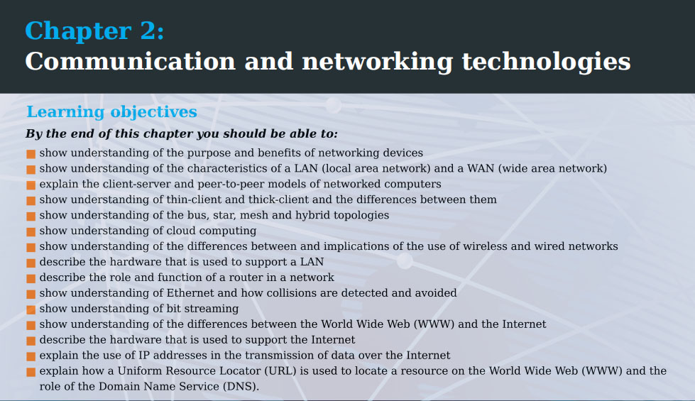

Slide 3
2.01
Evolution, purpose & benefits of networking

Slide 4
Class Overview
Network definition & features
Client-server model vs peer-to-peer
Types of network: PAN, LAN, MAN, WAN
Thin & thick clients

Slide 5
What is a network?
The definition is simple it’s simply “2 or more devices connected together”
This connection could be either wired or wireless

Slide 6
What are clients & servers?
First, we need to understand these 2 terms
Client: a device requesting (asking for) something
Server: a device responding to/fulfilling that request
e.g. a client computer could send a request for a website, then the website would respond with the web page to them

Slide 7
Network features
For regular users, they often associate a network as being the Internet, allowing them to browse the web etc
For businesses, schools, governments, hospitals etc, there are also be other useful features that could be included within their network…

Slide 8
Network features
Communicate (e.g. send files/messages) with other local devices and/or Internet
File server: anyone with permission can access
Application server: software installed in 1 location, but can be used by everyone in the company
Email server: send/receive/store emails internally
Database server: host databases internally
Print server: allow many computers to use 1 printer
etc

Slide 9
File Server
You can create a file server and map it to an empty drive on your PC – say F://
Permissions can be granted to users/groups allowing them to read and/or write those files
This means you only need 1 copy (rather than a copy on every individual computer) – saves space, ensures don’t have conflicting versions/copies etc
Makes collaboration/organisation easier

Slide 10
Types of network (smallest → biggest)
PAN: personal-area network (Bluetooth)
LAN: local-area network (e.g. router in one-building)
MAN: metropolitan area network (one city)
WAN: wide-area network (multiple cities/countries)
The exam will generally only ask about LANs & WANs…though once or twice I have seen them ask about PANs & MANs

Slide 11
Local Area Network (LAN)
this is a network within the same building
nodes don’t necessarily have to be connected to the Internet – could just be connected to each other (intranet)
WiFi & Ethernet (twisted pair) are the most common connection methods
application/file/print/email servers can be used to share files/applications, allowing all computers to print via a single/small group of printers, allowing the site to have an internal email system etc

Slide 12
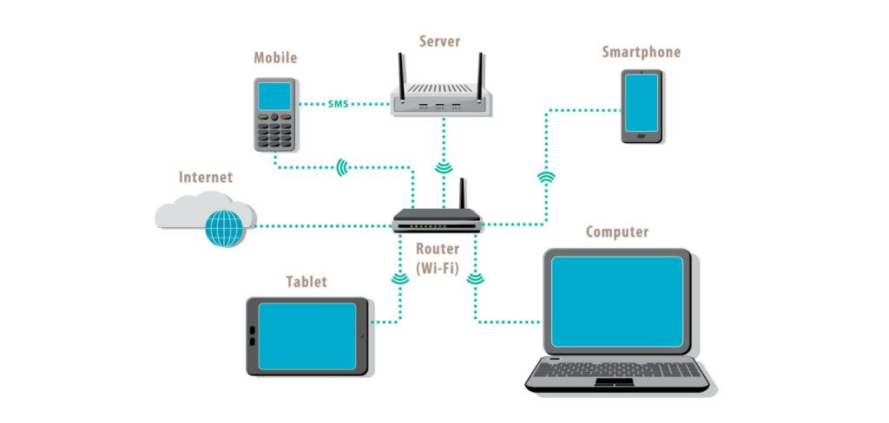
The most common server in a home environment would be a printer
File/email/database (etc) servers would be more common in businesses, schools, hospitals etc

Slide 13
Wide Area Network (WAN)
computers could be on other side of the world
allows sharing of files/software between all on the network
a ‘job’ could be run on remote computer that had required software – e.g. processing some data
traditionally slower than LANs, though less of an issue today (with 100Gb+/s connections)

Slide 14
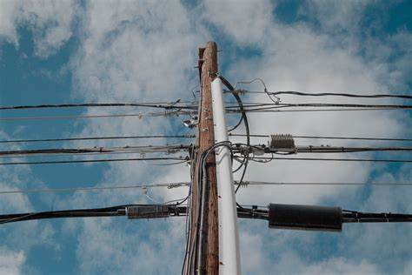
Wide Area Network (WAN)…Continued
traditionally locations would have been connected together with ‘leased lines’ (rented from PSTN/cable company/government)
these days, fibre optic cables are often used – and different companies can buy different wavelengths to send their data along a shared line
a software approach (SD-WAN) is sometimes used due to its cheaper price
switches will connect WAN locations together

Slide 15
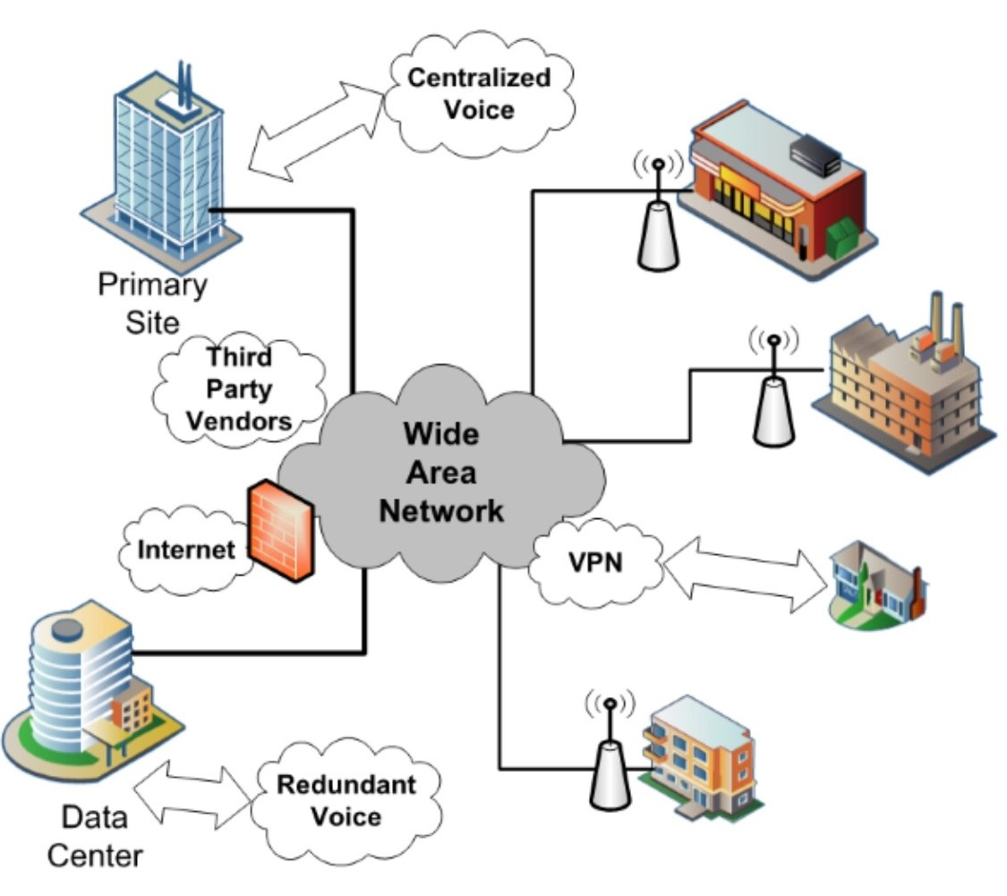
WANs are usually used for businesses, governments and even some universities who have sites in different cities/countries

Slide 16
For example, someone in the headquarters or factory would be able to access the same shared files, email server, intranet etc

Slide 17
Client-server model
Can you remember the definitions we gave for clients & servers?
Client: a device that sends a request
Server: a device that fulfills that request
So this is the client-server model – simply that a client requests something and a server fulfills that request

Slide 18
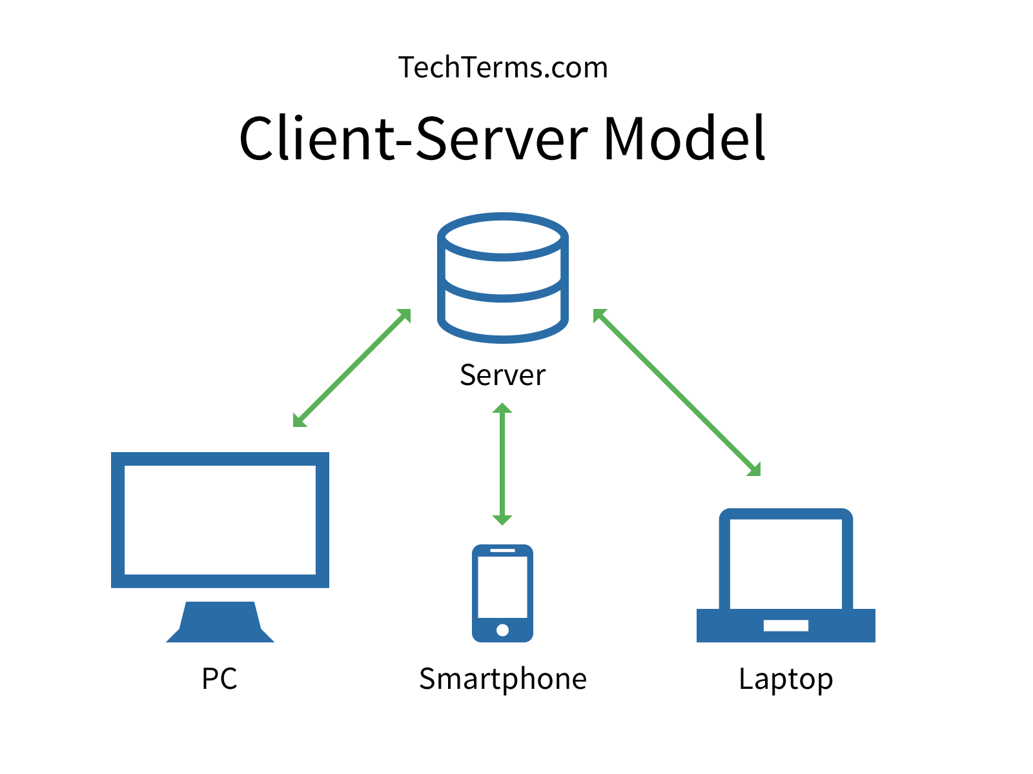
Client-server model
In real life, there could be millions of clients (e.g. users currently watching YouTube)
In these situations, there would also be multiple servers too – but the concept of clients requesting & servers fulfilling is the same

Slide 19
Requests
What kind of requests do you think a client might make?
Visiting webpages - HTTP(s)
Sending/receiving emails (SMTP, POP3, IMAP)
Transferring files (FTP)
Requesting information from database
Sending files to print server
etc

Slide 20
Clients
Note: the client can also be considered the software making the requests on the client’s device too – e.g:
The web browser would be the client in a web request
The email program would be the client when sending/receiving emails
The Whatsapp desktop app would be another example
etc

Slide 21
Thin-clients vs thick-clients
Client architecture can be grouped into two categories:
Thin-clients: little processing performed on client – it’s mostly done on server & client just displays it (either GUI or CLI)
Thick-clients: most processing done on client, not server
Note: “thick clients” used to be called “fat clients”…both terms are often used, but the latter was possibly considered offensive

Slide 22
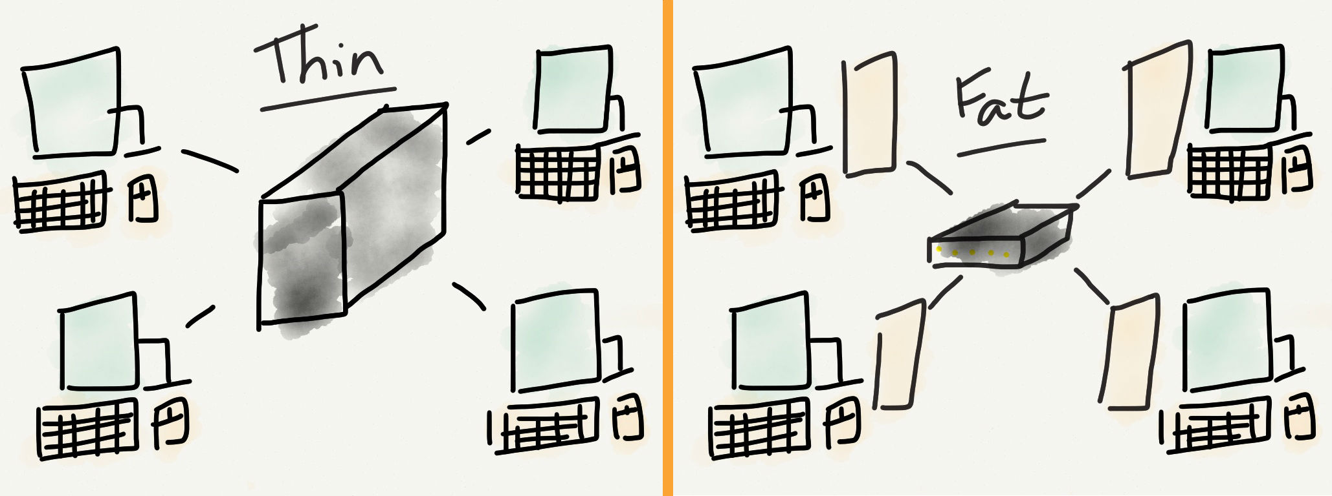
Thin client: limited/no processing capabilities
Thick client: high processing capabilities

Slide 23
Thin client advantages
Companies could host applications on a single server – cheaper than needing a license to install the software on every computer
User doesn’t have to download huge files (think Photoshop (1+GB) vs online equivalent (<5MB))
Saves data storage space – only need 1 copy of program/files etc
Can reduce administration/operation/purchasing costs by 70%
Can reduce energy usage by 97%
Updates/management is easier – only needs to be performed on the central server
Less downtime - IT staff don’t have to waste time fixing problems on user PCs (that users themselves may have caused)

Slide 24
Thin client advantages…continued
Protected from unauthorized software or viruses
Data can’t be copied to a disk or saved to any location other than server
Centralised server makes it easy to manage & monitor
Setup is quicker
Users can access apps and data from virtually anywhere

Slide 25
Thick client advantages
Reduces load (hence financial cost) on the server, since it’s offloaded to client
For web servers, if your clients aren’t within same company, it makes sense that you want the client (in many cases, their browser) to do as much of the processing as possible
Can provide quicker response times, since they don’t require data to be sent/received along the network
Often allow for greater customizability for individual users
Easier to create complex programs & GUIs that run locally, than on a central server

Slide 26
File-Sharing
There are two models for file-sharing:
Client-server model – as we’ve seen, a client can request a file from a server and the server can send it
Peer-to-peer (p2p) model – each peer (node/seeder) can store either the whole or parts of the file – when user is downloading, they could be downloading different parts of the file from different users (seeders) simultaneously

Slide 27
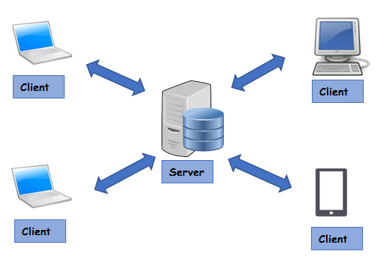
Client-server model

Slide 28
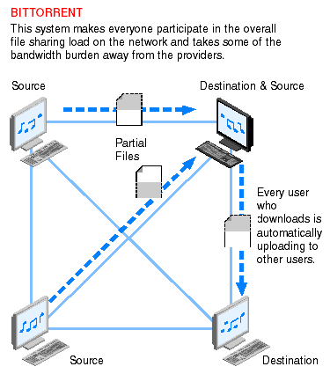
Peer-to-peer model
Note:
Multiple seeders (sources) sending different parts of the file(s)
Peers (nodes) can download (leech) & upload (seed/send)

Slide 29
Client-server model for file-sharing: advantages
Guaranteed to be able to get the whole file
Easy to setup/manage (add, delete, rename, copy etc) files, since they’re all stored in one place
Less viruses - i.e. if downloading from a reputable company, you can be fairly sure the download will be safe
User doesn’t require additional software to download files (like they do with p2p)
These days, you can also get fast downloads too (at university, we could download 1GB in 20 seconds), so the whole “client-server model is slow” isn’t such an issue now

Slide 30
Peer-to-peer model for file-sharing: advantages
Can be faster than client-server downloading, since you can download different parts of the file simultaneously, rather than having to download from 1 stream, in sequential order
Can be multiple copies of same file, so resistant to server malfunctions, original file not becoming available (e.g. if company goes bankrupt), police takedowns etc
More anonymized (private) for downloaders (leechers)

Slide 31
Peer-to-peer model for file-sharing: disadvantages
If no one is actively-seeding the file, you won’t be able to download it
If users only have part of the file, you may be unable to download the complete file – e.g. downloads getting stuck at 99.9% etc
Due to higher anonymity, potentially more likely to contain malicious files/viruses

Slide 32
Recap
Do you know the definition for a “network” in computing?
A network is 2 or more devices connected together
What 2 categories do we break devices down into (hint: “c” and “s”)
Clients & servers
What devices might be considered clients & servers respectively?
Clients: user computers/”dumb terminals”, even a web server requesting data from another web server etc
Servers: web servers, file servers, printers etc

Slide 33
Recap
What is a LAN and WAN? When are each used and what communication mediums do they use?
LAN = local-area network. Used for homes/small offices etc and use WiFi/twisted pair cables.
WAN = wide-area network. Used for businesses/governments/universities etc with buildings in many different locations – can use fibre optic, twisted pair, satellite etc to connect those in different locations

Slide 34
What are thick (fat) & thin clients – what the advantages & disadvantages of each?
Thick clients: do all/most of processing; server does no/limited processing. Advantages: reduced server load, don’t have to wait for network transmission, greater control, easier to create programs for
Thin clients: do no/little processing; server does all/most processing. Advantages: single copy of programs/data, less storage requirements, remote access, cheaper, easier to install/manage/update/protect, less energy, less downtime, data harder to copy (e.g. by disgruntled employee)

Slide 35
What is the client-server model and how does it differ from the peer-to-peer model – list some advantages of each
Client makes requests and server processes and responds to these requests – whole file will be available, trustworthy/less viruses, easy to manage, additional software to download not required
Peer-to-peer is a network of many nodes – each can upload/send (seed) or download/receive (leech) full/partial files – can be faster due to simultaneous seeders, resilient to nodes going down due to (hopefully) multiple copies being available on network, more anonymous

Slide 36

9618 AS
Unit 2
Network Topologies

Slide 37
Class Overview
Network Topologies: point-to-point, bus, full/partial mesh, star, hybrid – advantages & disadvantages
Communication system requirements
Communication/transmission modes
--- Briefly ---
Transmission mediums
Network hardware
Collisions & terminators

Slide 38
Network topologies
A network topology refers to the physical and/or logical layout of a network – the 4 we need to know are the:
Point-to-point
Bus
Star
Mesh (full & partial)
Hybrid

Slide 39
Key Concepts
Before we talk about these, the book will introduce some other concepts first…

Slide 40
Communication System Requirements
There are 5 requirements for digital communication systems:
sender
receiver
transmission medium (WiFi, twisted pair, co-axial, fibre-optic, satellite)
message
protocol (HTTP(s), FTP, SMTP, POP3, IMAP, ethernet etc)

Slide 41
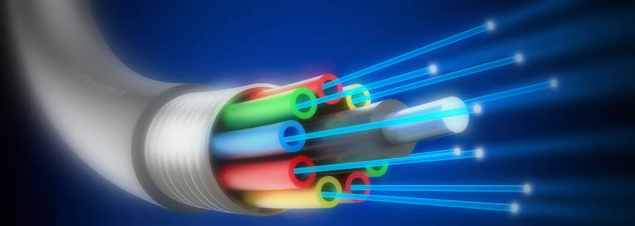
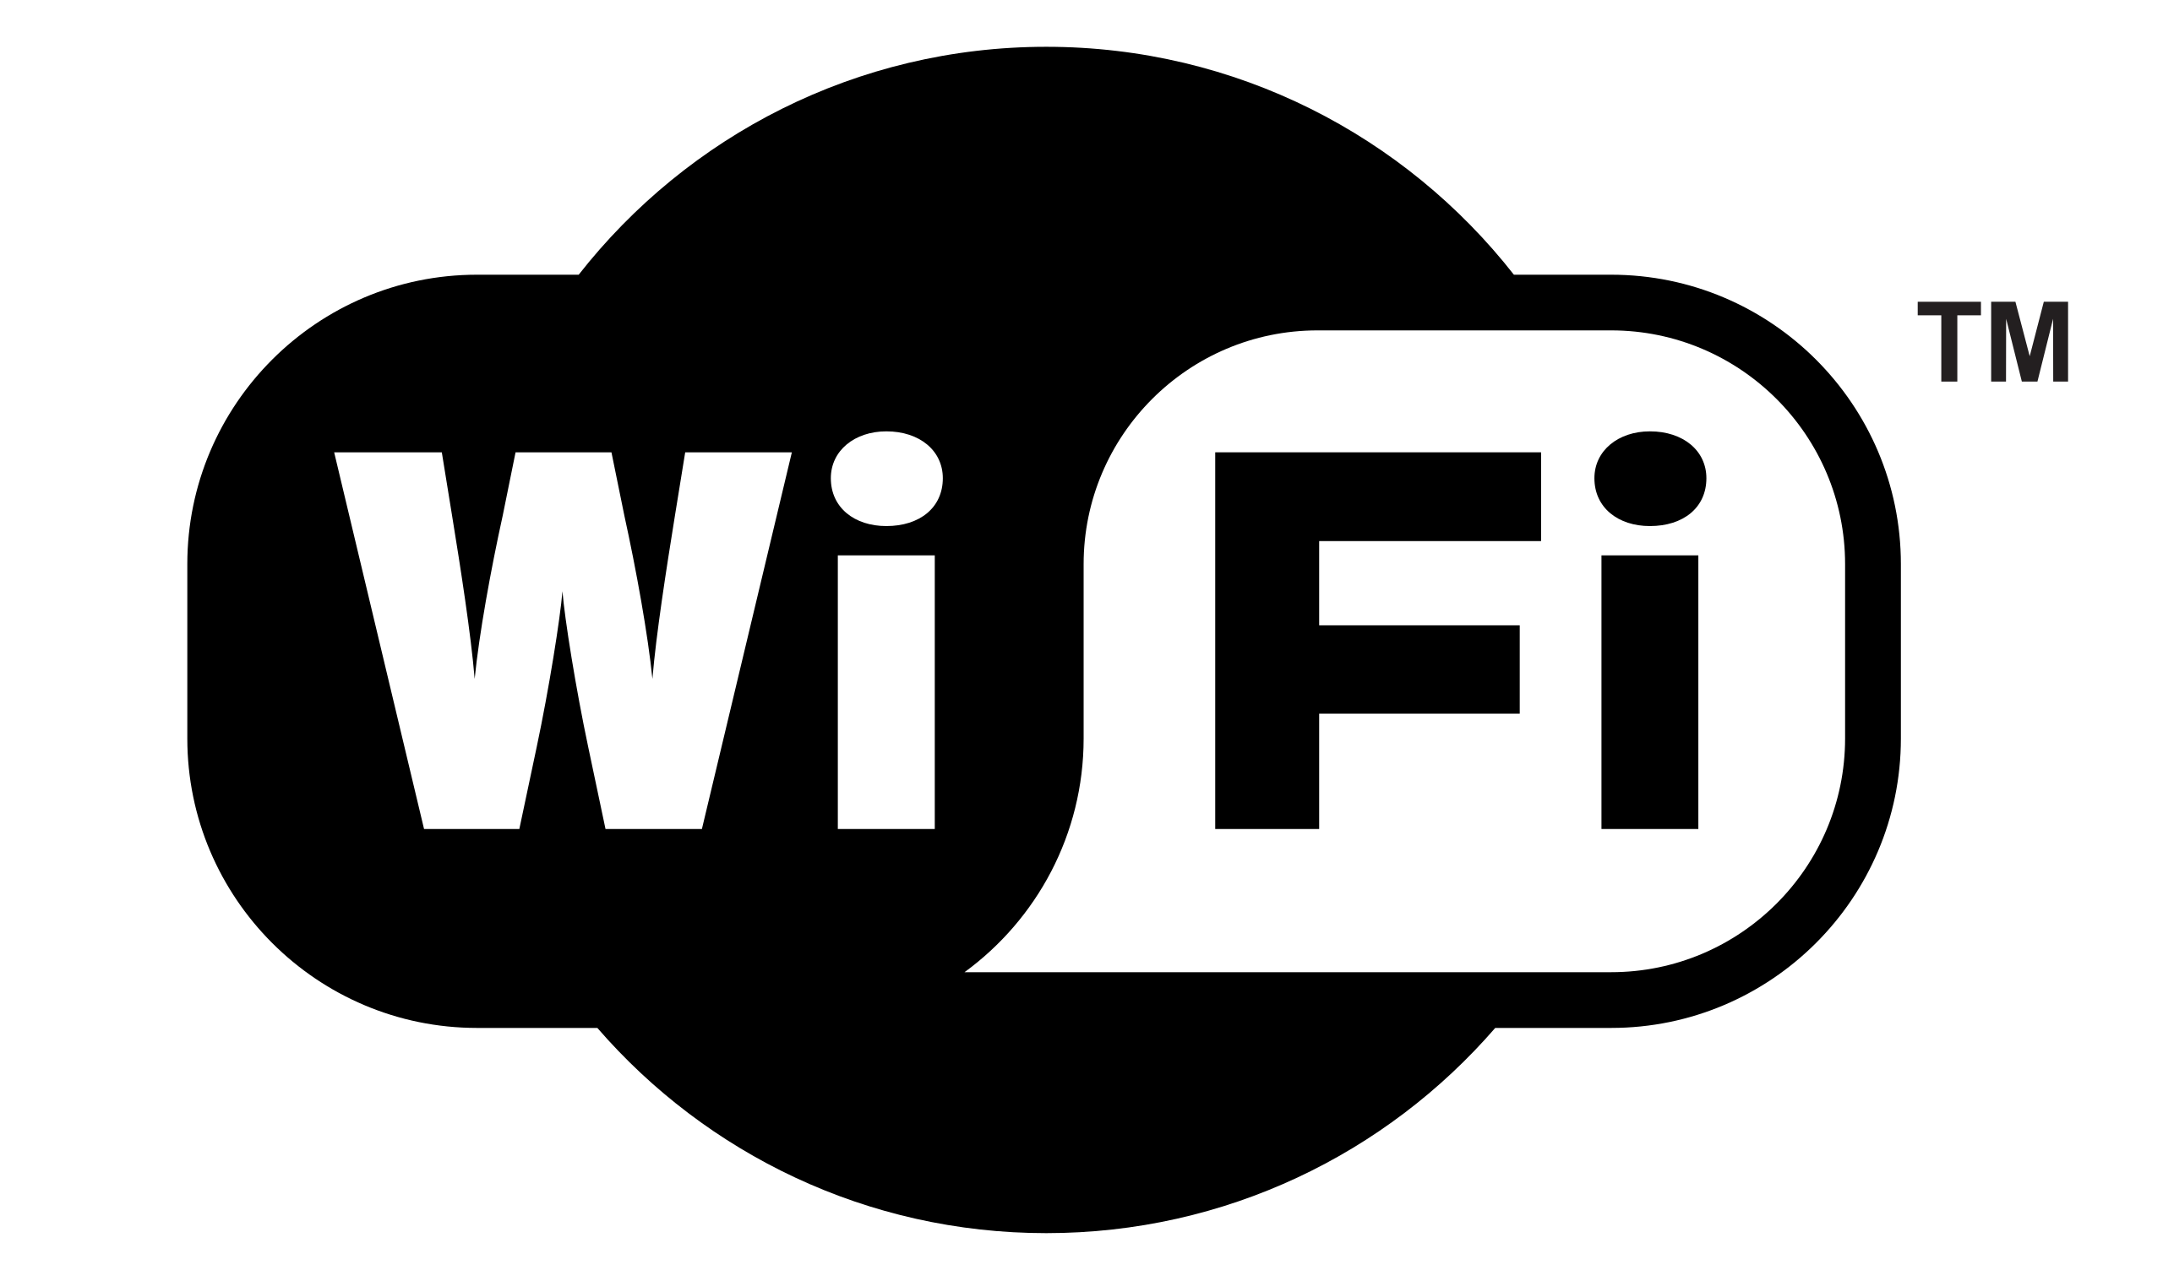
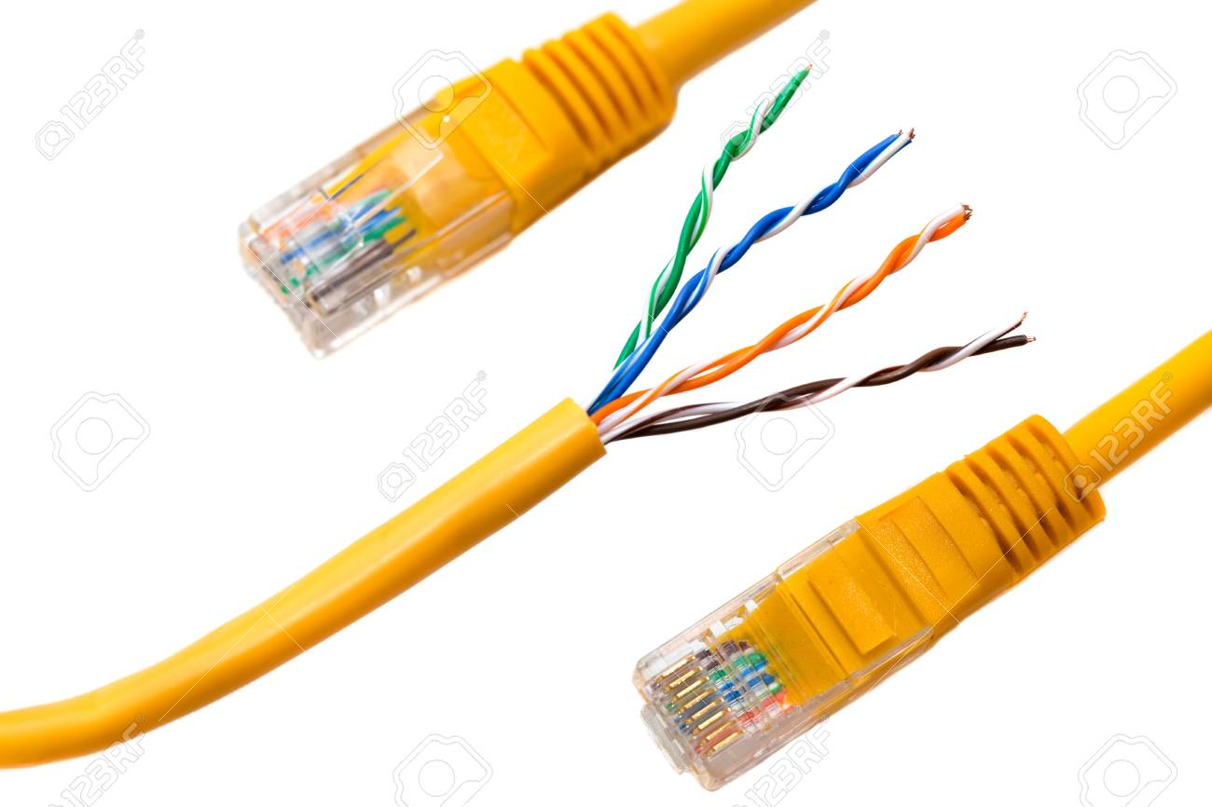
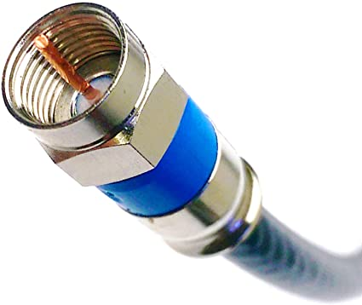
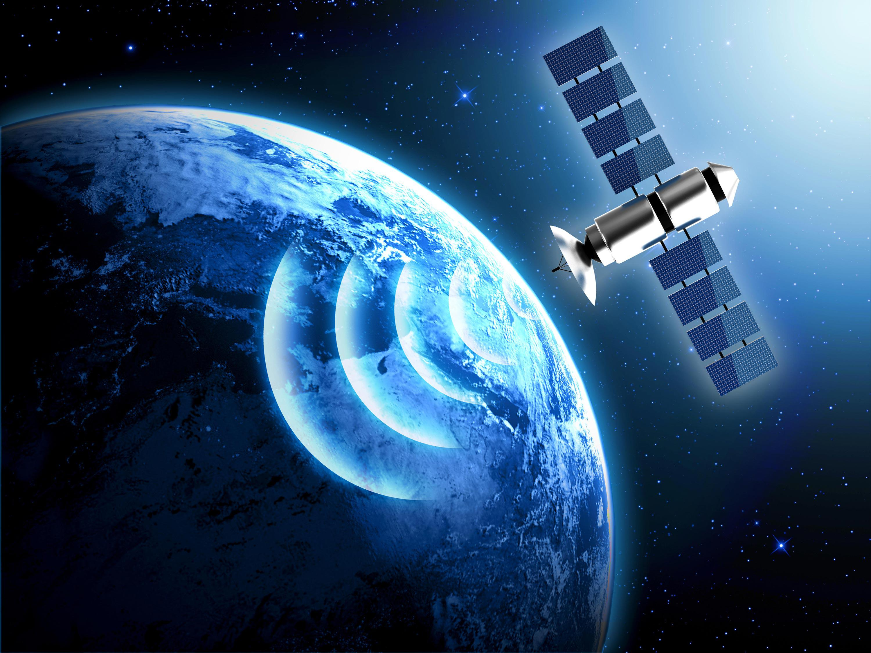
Transmission Mediums
Fibre optic
WiFI
Twisted pair cables
Co-axial cable
Satellites

Slide 42
Transmission Modes
Data can be sent via the medium in 3 different ways:
Simplex: data flow in one-way only
Half-duplex: data flow is bi-directional, but not simultaneously
Full-duplex: data flow can be bi-directional and simultaneous

Slide 43
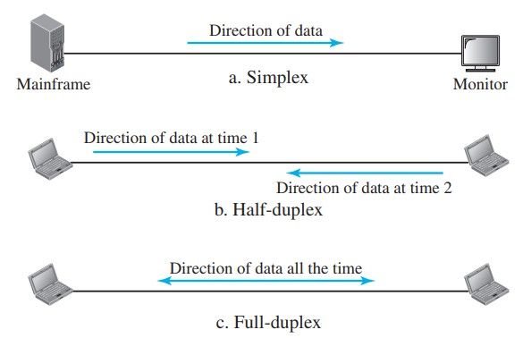

Slide 44
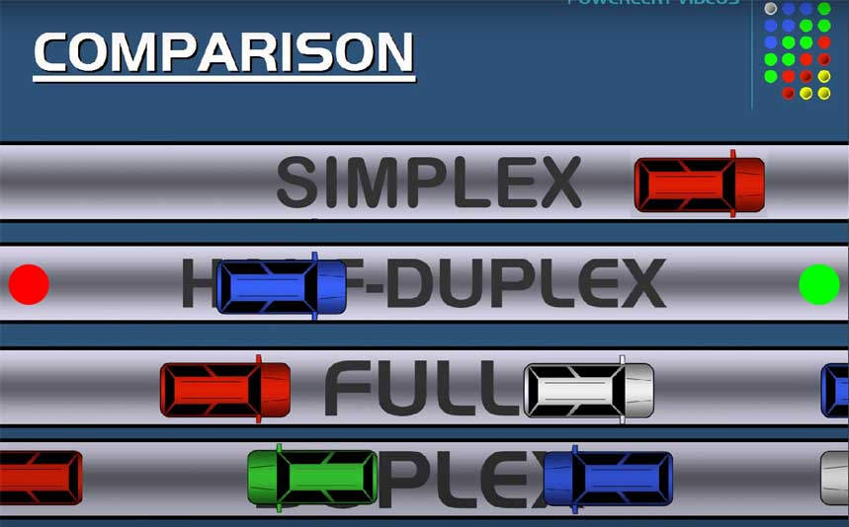
Imagine roads & cars representing each transmission type – how do you think they would look?
Simplex
Half-duplex
Full-duplex

Slide 45
Simplex vs Half-Duplex vs Full-Dulpex
Full-duplex offers the most features – half-duplex is rarely used these days and the main advantage is price
There are specific cases where half-duplex and simplex could be ok/even advantageous
e.g. maybe for security, we want data to go from one device to another, but not the other way

Slide 46
Messages
A ‘message’ is simply data – it could be text, an image, video, audio, json etc
Messages will sent during the communication

Slide 47
Message Transmission
Messages can be transmitted in 3 different modes:
Unicast – one-to-one communication
Multicast – a targeted signal, from one source to multiple destinations
Broadcast – signal is sent indiscriminately – anyone who ‘tunes in’ can listen (e.g. tv/radio)

Slide 48
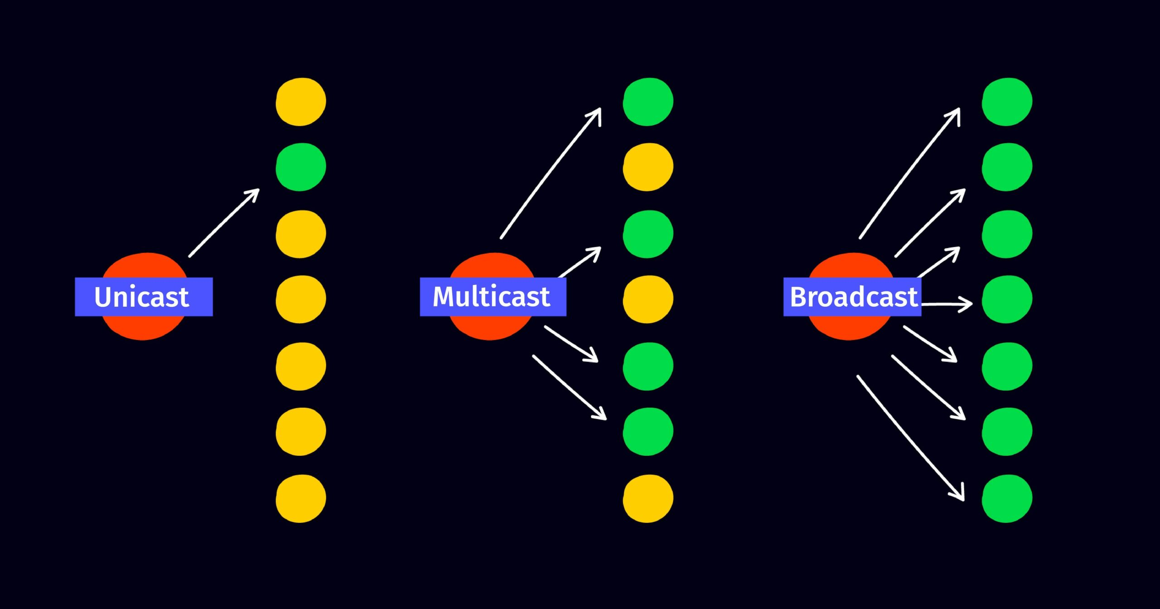

Slide 49
Network Devices
Hubs – receive messages & broadcast them to every device on the network
Switches – receive messages and support sending via unicast, multicast & broadcast
Routers – forward packets onto the next device (based on routing table) so they can arrive at their destination
Bridges – join 2 separate networks of same protocol
Gateway – entry & exit point to network - converts data from one protocol to another

Slide 50
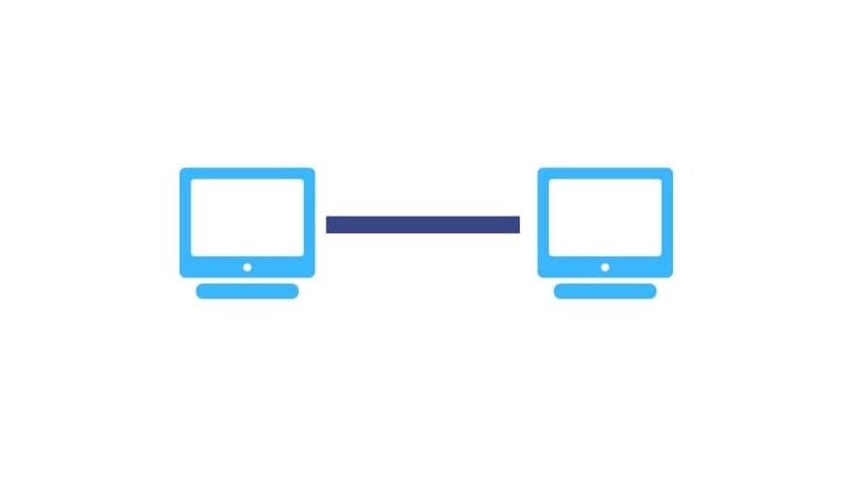
Point-to-point topology
Point-to-point topologies are direct connections between 2 devices and could be connected via twisted-pair, WiFi, fibre-optic etc
Transmission could be simplex or half/full-duplex, but, since there is a direct connection, the message can only be sent unicast

Slide 51
Point-to-point topology advantages
Secure – eavesdropping is hard/impossible, hence can connect critical/specialist servers together – e.g. database and file server generating financial reports in a bank
Fast & reliable – dedicated connection, hence no collisions/lower congestion etc

Slide 52
Point-to-point topology disadvantages
Not general purpose – can only connect two devices
No redundancy – single point of failure
Expensive – need dedicated connection between device

Slide 53
Bus topology
A linear topology in which the ends do not rejoin & are terminated with a terminator (represented with black circle)
Messages have to be broadcast along the line
Hence anyone can intercept them, even if they weren’t intended for them
Encryption can be used so they can’t be decrypted by unintended users, but they will still be able to see some details – like when, how much data and between who communication has taken place

Slide 54
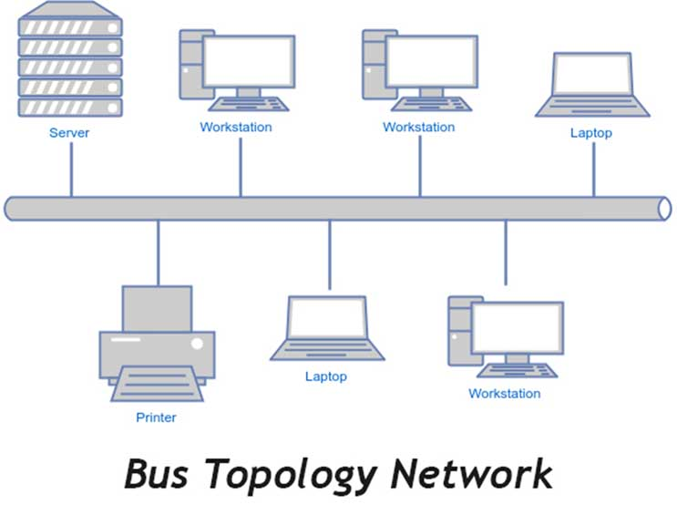

Slide 55
Bus topology
Why do you think it’s called a bus topology?
messages travel along the line like a bus travels along the route
devices are like stations
terminators are the start/stopping point of a route

Slide 56
Terminators
A terminator is just a device with high resistance – think about physics – why would a bus topology require terminators?
Terminators absorb the electrical signal – otherwise it’d reflect back down the line and create interference

Slide 57
Bus topology: advantages
Semi-resilient - a fault in a node or a link connecting a node to a bus won’t prevent communication between other nodes
Relatively easy to implement
Efficient for small networks
Less network cable/cheaper e.g. star/mesh networks
Easy to expand – simply add device to existing line

Slide 58
Bus topology: disadvantages
Slow for large networks, since each additional device slows network down
Potential for eavesdropping, since data intended for a particular client is broadcast along public bus
Identification of problem difficult if there’s a fault in the line (as opposed to e.g. star topologies, where the specific problem link can be identified)
Chance of collisions – hence packet loss is high

Slide 59
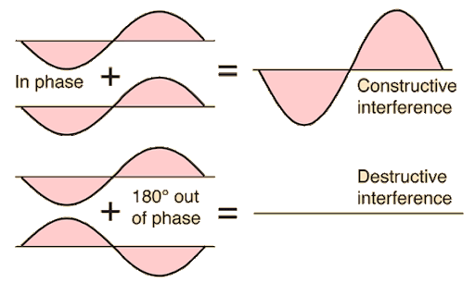
Collisions
We will talk about collisions and how they can be avoided later (they aren’t an issue for star/mesh networks)
Basically, it’s when two devices transmit at the same time and cause interference, corrupting the signal
Constructive & destructive interference

Slide 60
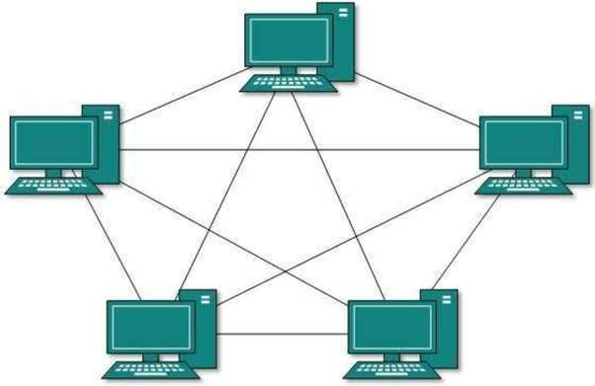
(Full) Mesh Topology
Each node has a point-to-point connection with all others
Transmission is usually full duplex & messages can be sent as unicast, multicast or broadcast
If a connection unavailable, the message can be sent along another path

Slide 61
(Full) Mesh Topology
Why do you think this topology usually isn’t used to connect end devices?
Since too much wire would be required (and it’s usually not required to have a direct connection between e.g. 2 staff members)

Slide 62
(Full) Mesh Topology
If we have n devices, do you know the formula for the number of connections?
n(n – 1) / 2
So, for 100 devices, that would be 4,950 connections…which is not realistic

Slide 63
(Full) Mesh Topology
Hence, this topology is usually used to connect more ‘important’ devices – like servers, routers, switches, bridges etc

Slide 64
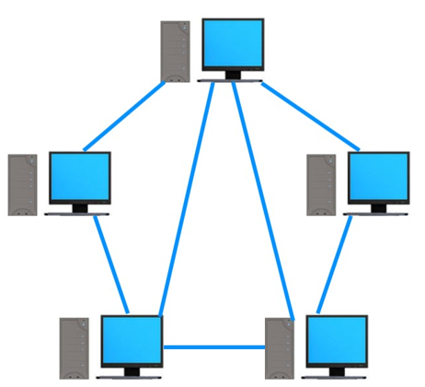
Partial Mesh Topology
We don’t need to connect every device – for example, a web server would probably need to be connected to the database server & email server, but not the print server

Slide 65
Mesh Topology: Advantages
Offers full-duplex communication
Offers all 3 transmission types: unicast, multicast & broadcast
Supports high traffic load, since multiple devices can transmit data simultaneously across different wires
Resilient: failure of one line only causes that particular line to go down – other routes can then be used

Slide 66
Mesh Topology: Advantages (continued)
High privacy & security due to dedicated connections
Adding additional devices doesn’t disrupt data transmission between current devices
Fault identification is easy (since you know exactly what line is down)
No centralized authority

Slide 67
Mesh Topology: Disadvantages
Expensive, due to large amount of wiring
Building & maintaining is extremely difficult even with a relatively small number of devices
High power consumption
Could have redundant connections, even if a partial mesh is used

Slide 68
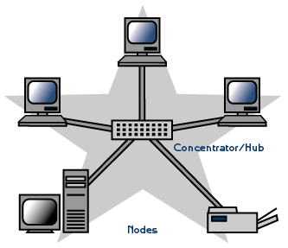
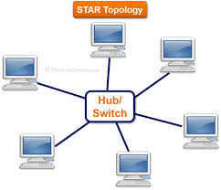
Star Topology
Central switch all devices go through to communicate with others
Switches support unicast, multicast or broadcast
Hubs only support broadcast (so are rarely used these days)

Slide 69
Switch will store list of IP & MAC addresses, so packets can be sent to correct device(s)
Note: the star topology is the most used in practice – it’s more common than point-to-point, bus or mesh
Your home network will almost certainly be a wireless star network – devices connecting to a central switch/router
Star Topology

Slide 70
Star Topology
If one line goes down, only that 1 end device will be cut-off
If the central switch/hub fails, the whole network stops working

Slide 71
Star Topology: Advantages
Offers full-duplex communication
Offers all 3 transmission types: unicast, multicast & broadcast
Due to hub-nodes having point-to-point communications, there are no collisions
Each device only needs one I/O port to connect to switch
Relatively easy to implement
Easy to identify fault, due to point-to-point links
Resilient due to point to point links (unless central hub goes down)

Slide 72
Star Topology: Disadvantages
If central switch/hub fails, the whole network fails
More expensive/more cable than bus…but less than full/partial mesh
Switch can be under high load in large network
Extra hardware (switch/hub) required compared to bus topology
Performance depends on the switch (specs, throughput, load etc)

Slide 73
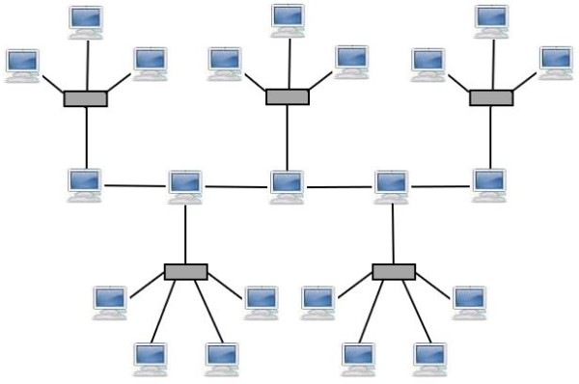
Hybrid Networks
It’s also possible to create a network with multiple topologies – this would be called a hybrid network
What 2 network topologies can we see here?
A central bus line with star networks connecting to it

Slide 74
Hybrid Networks
Suppose we have some important devices (file, web, email & print servers) as well as some regular user PCs – suggest a possible hybrid network structure?
The important devices could be connected as a mesh (full or partial), while the PCs could be connected to switches via a star topology

Slide 75
What are the 5 requirements for digital communications?
Sender, receive, message, communication medium, protocol
What are the 3 ways a message can be transmitted between individualy devices?
Simplex, half-duplex & full-duplex
What are the 3 ways a message can be transmitted between multiple devices?
Unicast, multicast, broadcast

Slide 76
Can you list 4 network topologies? What are the advantages & disadvantages of each?
Point to point: secure, fast, reliable, private, only communicate with 1 other device, expensive if you need many point to point connections
Bus: Cheap, easy to implement/expand, efficient enough for small networks, resilient if a node/link unavailable, collisions, slow, eavesdropping, problem identification difficult
Full/partial mesh: fast, resilient – rerouting, private, secure, full-duplex, 3 transmission types, adding new devices/identifying faults easy, no central authority, expensive, lots of wire, difficult to manage, high power
Star: no collisions, fast, cheap/low wire, setup/fault identification easy, full-duplex, 3 transmission types, resilient if end device/connection drops, all packets go through central switch – high load = slow, single point of failure, less private/secure

Slide 77
Which communication mode (simplex, half-duplex or full-duplex) and transmission mode (unicast, multicast or broadcast) does each topology support?
Topology | Communication Mode | Transmission Modes
Point to Point | All | Unicast
Bus | Simplex & half-duplex | All
Mesh | All | All
Star | All | All
?

Slide 78

9618 AS
Unit 2
Transmission Media

Slide 79
Class Overview
Transmission media: twisted pair, coaxial, fibre optic, WiFi, satellites
Wired vs wireless
Local vs global communication
Key terms: attenuation, bandwidth, repeaters, guided, unguided, shielding, channels, interference

Slide 80
Transmission Media
As stated, there are 2 methods in which data can be transmitted between devices
Wired (twisted pair, coaxial, fibre optic)
Wireless (WiFi, satellite, bluetooth)

Slide 81
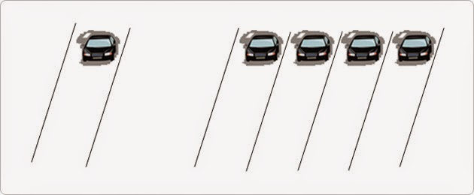
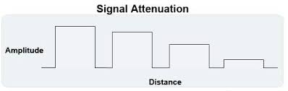
Key Terms
Bandwidth: a measure of the amount of data that can be transmitted per second (usually in Mb/s or Gb/s)
Attenuation: the rate at which the strength/intensity of the signal decreases

Slide 82
What factors do you think affect bandwidth?
How would these factors relate to the cars on a road analogy?
Physical speed of data transmission/speed of each car
Frequency of transmission/distance of one car to next
Number of active channels/lanes
In most cases, points 2 are 3 are the deciding factors (since both electrical & electro-magnetic waves propagate extremely fast)

Slide 83
What factors do you think affect attenuation?
Substance data is transmitted through – copper, air, buildings/walls, rain, vacuum etc
Frequency – low frequency waves (e.g. radio) attenuate less than high frequency waves (e.g. gamma)

Slide 84
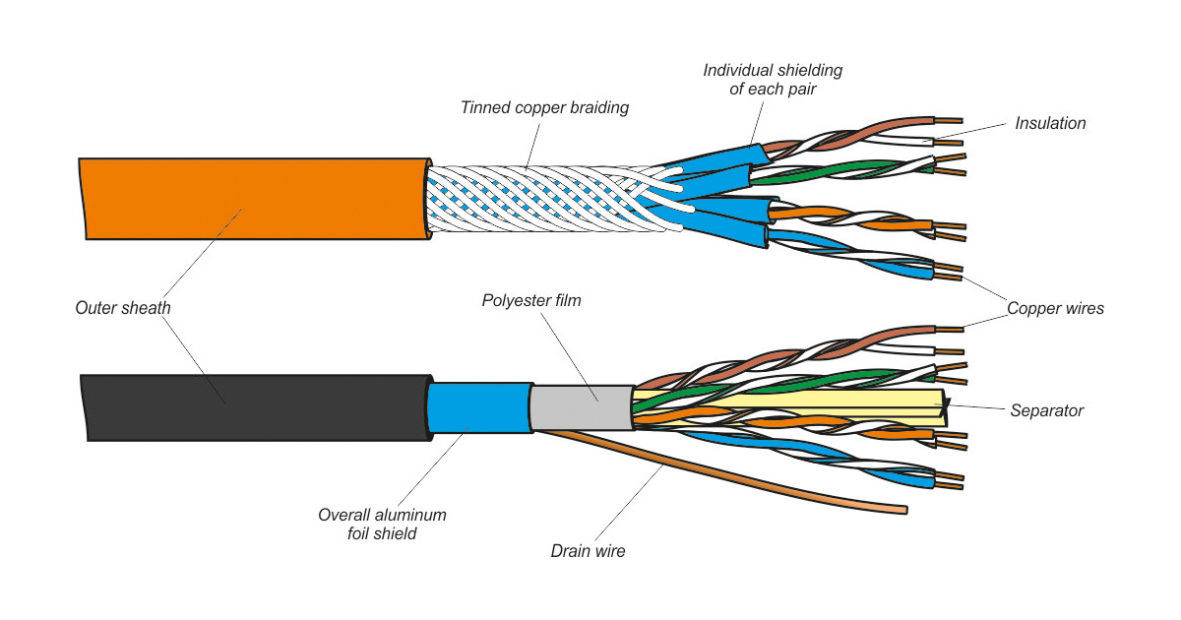
Twisted Pair
Insulation & shielding block electromagnetic interference from both outside and between the pairs
Twists also reduce EM interference

Slide 85
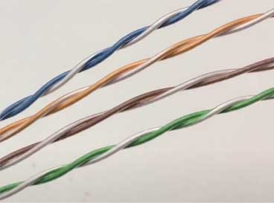
Twisted Pair
Different cables twisted different amounts – keeps wires out of phase to reduce crosstalk
More twists = less interference & higher frequency (hence bandwidth) supported, but more attenuation (due to higher capacitance & greater length of wire)

Slide 86
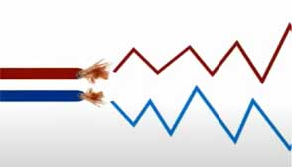


Twisted Pair – Extra Info
A signal sent on red wire; inverted signal on blue – difference between them is the final signal
If not twisted, outside EM signals hit wires hence induce current at different times
Twists ensure interference occurs at same time – hence difference stays same

Slide 87
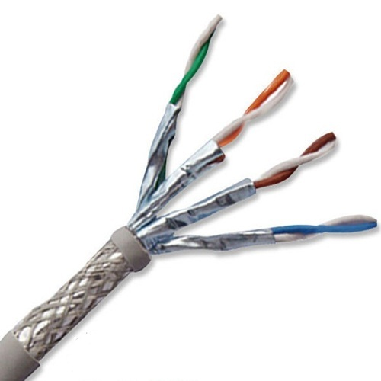
Twisted Pair: Shielded vs Unshielded
Shielded twisted pair also contains metal insulation to prevent interference
It is more expensive & usually not neccessary, so rarely used (mostly in data centers with high frequency wires or e.g. factories/environments with lots of powerful electronic/magnetic machinery)

Slide 88
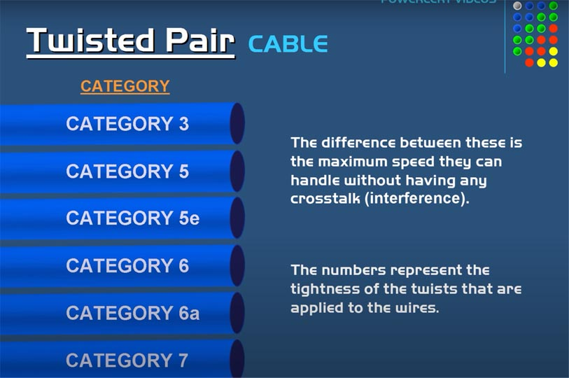

Slide 89
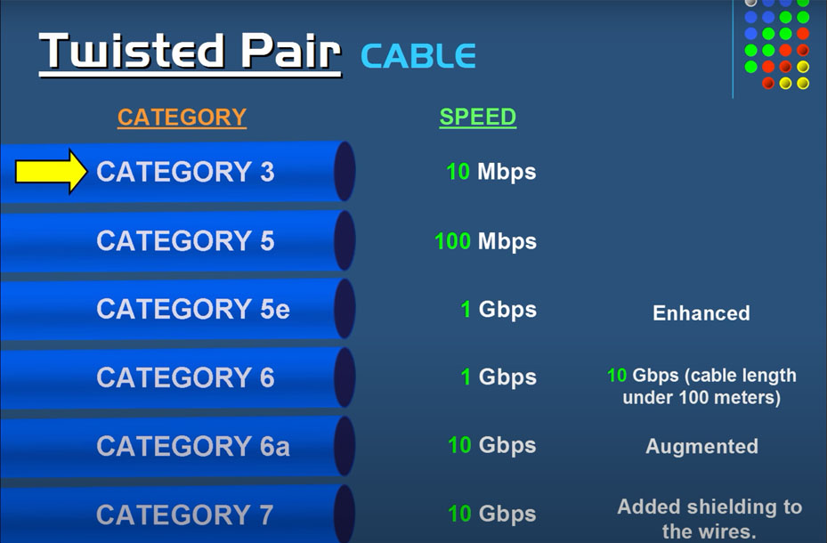

Slide 90
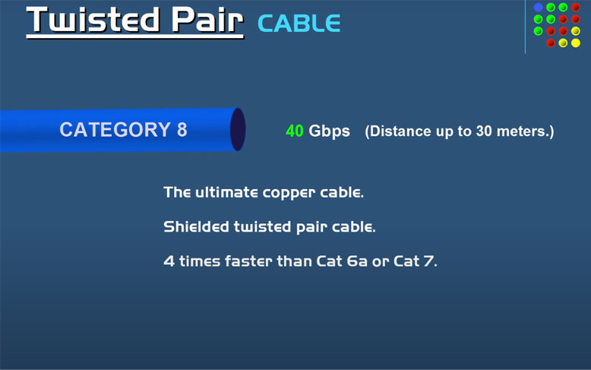

Slide 91
Twisted Pair – Advantages & Disadvantages
Cheap
Lower bandwidth
High attenuation
Strongly affected by interference
Requires many repeaters
Remember, this is relative – for home/office use, twisted pair is fine – for undersea cables spanning 10,000km used by millions, not so much – 40Gbps is more than enough for home usage for example

Slide 92
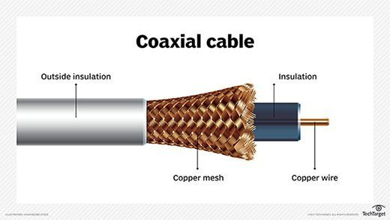
Coaxial
Again, contains insulation to reduce interference
Mainly used for broadband connections, (old) tv & radio, CCTV etc

Slide 93
Coaxial – Advantages & Disadvantages
Moderate cost
Moderate bandwidth
Moderately affected by interference
Moderate attenuation
Requires moderate number of repeaters
Note: the books say coaxial has the highest attenuation, though sources online from e.g. cable manufacturers say that twisted pair has higher attenuation than coaxial

Slide 94
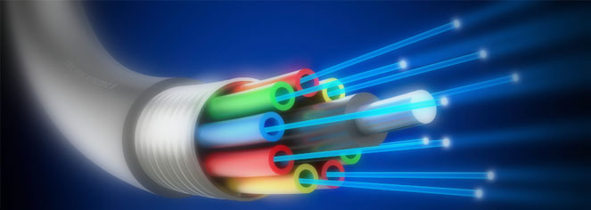
Fibre Optic
Light is transmitted at high frequencies through glass tubes

Slide 95
Fibre Optic Bandwidth
Current world record speed in a lab is 1Pb/s (10¹⁵)
Current commercial solutions tend to be about 100Gb/s
These bandwidths are per glass fibre (tube) – fibre is less affected by interference than copper cable methods (twisted pair or coaxial), so if you want 1Tb/s, we can simply use 10 100Gb/s fibres

Slide 96
Fibre Optic Bandwidth
It’s stated that fibre-optic cables could support a bandwidth of 100,000 twisted pair or coaxial cables – why do you think that is?
The speed propagation of voltage along a wire can be between 50-90% the speed of light – so this isn’t really the issue
The main reason is the frequency of light in a fibre optic cable (10¹⁵Hz) is >>> frequency of electrical signals in copper wire (10⁶Hz) – why do you think increasing the frequency increases the amount of data we can transmit per second?

Slide 97
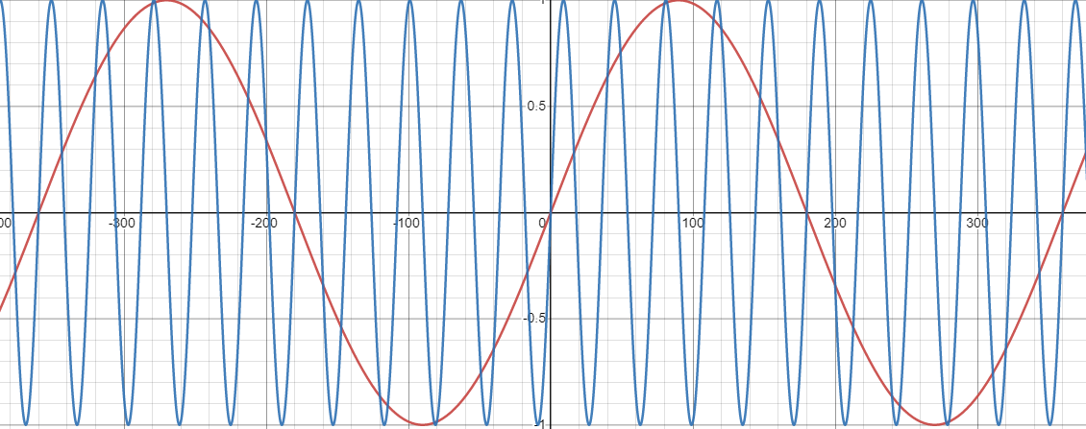
Fibre Optic Bandwidth
Here are the graphs for y = sin(x) and y = sin(10x)
Assume a peak = 1 and a trough = 0
Hence, higher frequency = more peaks & troughs per second = higher bandwidth
Between 4G & 5G Internet, which has a higher frequency?
5G – which is why the bandwidth is higher

Slide 98
Fibre-Optic Advantages & Disadvantages
Extremely high bandwidth
Lowest attenuation
Lowest need for repeaters
Least affected by interference
Expensive
Requires specialist equipment
Ignoring price, why doesn’t everyone use fibre optic?
Since for home/small office use, twisted pair supports up to 40Gb/s which is good enough – so it’s really only huge companies/ISPs that would need it. Some companies also have km of twisted pair – so switching to fibre optic would be very costly/time consuming.

Slide 99
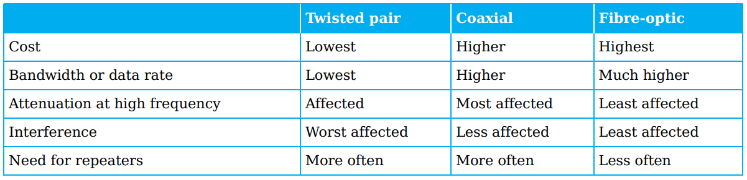
Transmission Media: Comparison
As stated, online sources state twisted pair suffers more attenuation coaxial
Then, it’s easy to remember: twisted pair is worst in everything, but cheapest; coaxial is in the middle for everything; fibre optic is best for everything, but most expensive

Slide 100
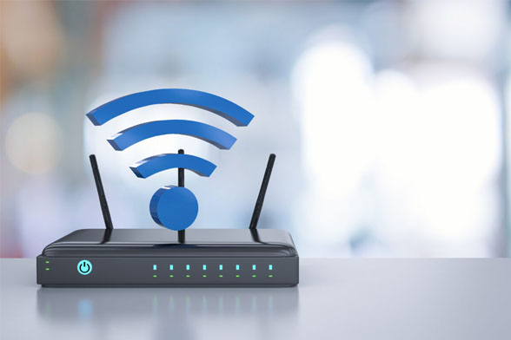
WiFi
Works by transmitting data over radio waves
Different channels (frequencies) used to reduce interference

Slide 101
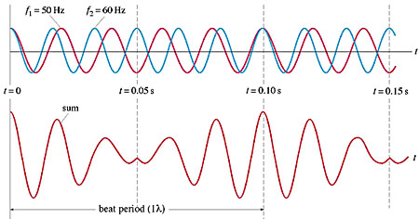
WiFi: Channels
Imagine you have 10 different WiFi networks, each with 10 devices all communicating on the same frequency – what do you think might happen?
You can get interference

Slide 102
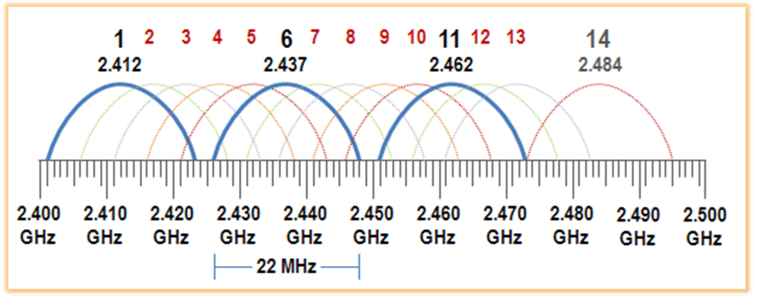
WiFi: Channels
To solve this, frequencies can be broken down into separate channels
To reduce interference, different networks & devices should communicate on different channels
Bandwidth utilization is also increased – data can be sent on quiet rather than congested channels

Slide 103
Guided vs Unguided Media
Guided means we can ‘aim’ the signal – by definition, cables provide a 1-to-1 connection, hence are guided
Unguided means the signal is sent in all directions – e.g. a wireless access point (WAP), radio tower or tv station sends the signal spherically (i.e. all directions)

Slide 104
Guided vs Unguided Media
Do you know what type of electromagnetic wave a remote control (e.g. for a TV, AC etc) uses?
Infrared – what happens if you don’t aim the remote control directly at the receiver?
The signal won’t be received – hence EM waves with higher frequencies are more guided than those with lower frequencies

Slide 105
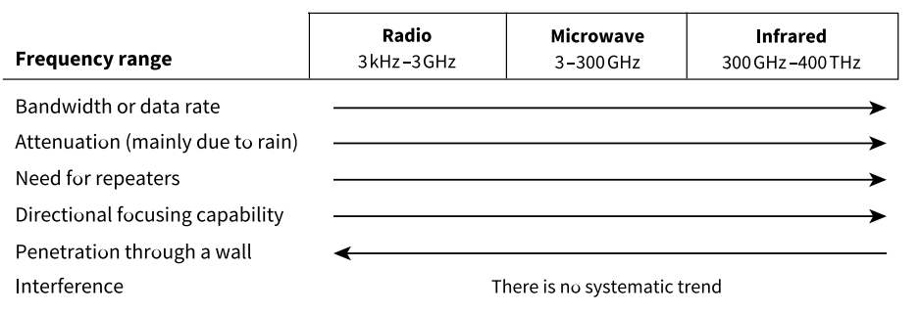
Wireless Frequencies
5G has a higher frequency than 4G – this is why it has a higher bandwidth, but has a shorter range, is more likely to get blocked by walls etc. There are also arguments about higher frequencies causing health issues

Slide 106
WiFi Advantages & Disadvantages
Accessible with portable devices (laptops, tablets, phones etc)
No cables required
Setup is easy/fast
Suitable for public locations – cafes, hotels, transport etc
Lower bandwidth
Less secure than cables – anyone can listen in (though data should ideally be encrypted)
High absorption rate (e.g. blocked by walls)
Short range (20 to 150m)

Slide 107
Transmission Media: Legal Issues
Do you think you can set up an antenna and start transmitting data?
On unused frequencies, yes – but if the frequency is used by the military, government, tv/radio station etc, you can get into legal trouble (fines or even prison) if the offense is severe enough

Slide 108
Transmission Media: Legal Issues
Do you also think cabling also comes with legal issues?
It possibly depends on the country – if it’s a private company installing cables, they will have to get permission to dig and lay the cables underground from the land owners (e.g. farmers)
If the telecoms company is owned/partially-owned by the government, the company shouldn’t really have any legal issues

Slide 109
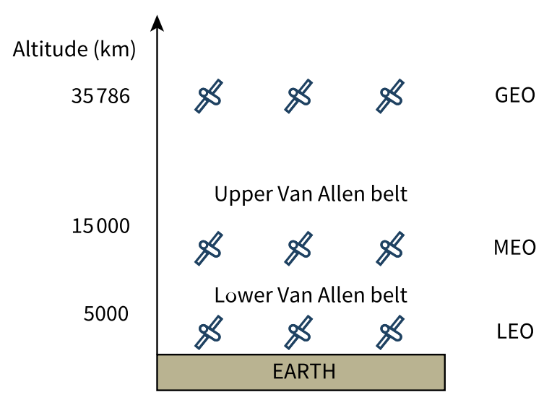
Satellites
Geostationary: stays above fixed position on Earth. 3 required for whole-Earth coverage
Medium-Earth orbit: provides GPs etc – 10 required for whole-Earth coverage
Low-Earth orbit: provide mobile phone network – 50 required for full-Earth coverage – Starlink operates at only 340km above the Earth’s surface
Note: Van Allen belts contains high levels of electrically-charged particles, hence satellites aren’t placed there

Slide 110
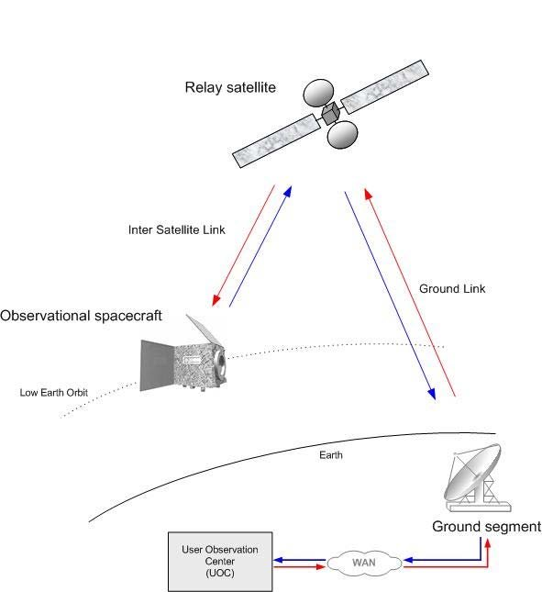
Satellites
Can act as component in a network or directly communicate with ground-based components
Ground-based components can be further apart than a network without satellites, since relay satellites have large view of Earth’s surface
Due to larger distances involved, high latency (time to receive first byte)

Slide 111
Satellites
In reality, due to high cost, latency, low bandwidth, satellites are only used for specialised applications where alternatives (e.g. fibre optics) aren’t available:
Internet access for mobile phones
GPS/military/tracking
Internet access in remote locations/after (natural) disasters
Internet access on planes

Slide 112
Satellite Advantages & Disadvantages
Accessible from virtually anywhere (even if local infrastructure has been destroyed) – i.e. remote locations/after (natural) disasters)
Specific use cases – e.g. GPS, mobile phone network, taking photos of Earth etc
Expensive
Lower bandwidth
Higher latency
Extremely complex
Repairs are difficult/impossible

Slide 113
Local vs Global Communication
We have looked at the following transmission mediums:
Twisted pair cable
Coaxial cable
Fibre optic cable
WiFi
Satellites
Which do you think would be good for local vs global communication & why?

Slide 114
Local Communication
For home/small office use, twisted pair & WiFi would be good options – coaxial is also fine too, but requires hardware that is less common these days
Afterall, for these situations, we don’t require the bandwidth that fibre optic provides – so these other mediums are sufficient
WiFi has the convenience of allowing people to move around and use non-computer/portable devices (phones, tablets, smart appliances etc)

Slide 115
Global Communication
If possible, for global communication, fibre optics will be used due to extremely high bandwidth and cheaper price, compared to satellites (fibre optic is more expensive than twisted pair/co-axial though of course)
If requiring GPS/mobile phone network/needing to provide connections to a remote location, then satellites will be used

Slide 116
How do the transmission mediums rank in terms of cost? How about attenuation, need for repeaters, amount affected by interference?
Medium | Cost | Bandwidth | Interference | Attenuation | Repeaters
WiFi | Cheap | Quite Low | Most | Very High | Very High
Satellite | V Expensive | Very Low | Very High | High | Low
Twisted Pair | Cheap | Low | High | High | High
Coaxial | Moderate | Moderate | Moderate | Moderate | Moderate
Fibre Optic | Expensive | Very High | Low | Low | Low
?
Note: satellite signals can travel with low attenuation in vacuum of space – but attenuate when encountering clouds, charged atmospheric particles, solar flares etc

Slide 117
What are the advantages & disadvantages of wireless compared to wired transmission?
Wireless: portable devices/remote locations, convenient, easy to setup, lower bandwidth, less secure
Wired: higher bandwidth, more secure, requires additional hardware (cables)
What medium would be suitable for long-distance (cross-country/undersea etc) cabling? What might be preferred for a mid range and large office respectively?
Long-distance: fibre optic – very high bandwidth, low attenuation/need for repeaters
Small office: twisted pair – cheap, bandwidth high enough for few devices
Large office: coaxial – relatively cheap, higher bandwidth than twisted pair

Slide 118
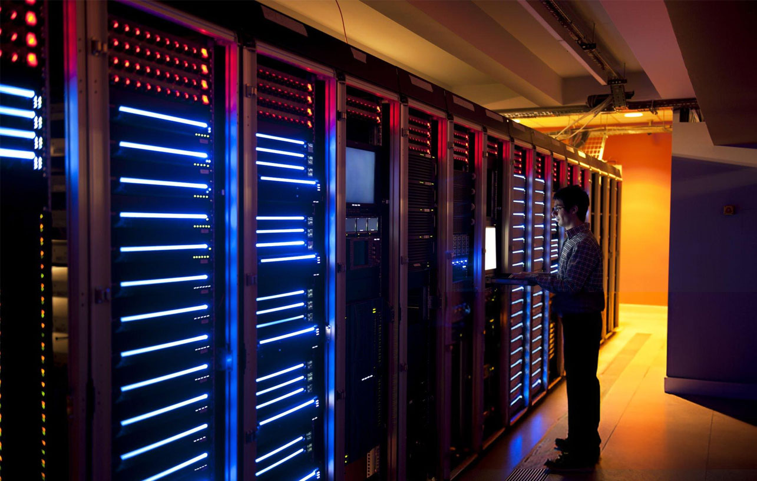
9618 AS
Unit 2
Network Hardware

Slide 119
Class Overview
Network Hardware: terminators, repeaters, rj-45 connectors, bridge, hub, switch, (wireless) network interface card/controller, wireless access point, gateway, router
Routing tables
Legacy vs Modern Ethernet
Collisions & CSMA/CD (carrier-sense multiple access with collision detection)

Slide 120
Hardware: Cabling
Previously co-axial cables was the most common way to connect devices on a LAN
These days, twisted pair is the most common.
Fibre optic cables will be used to provide the backbone (between cities, undersea etc) for ISPs)

Slide 121
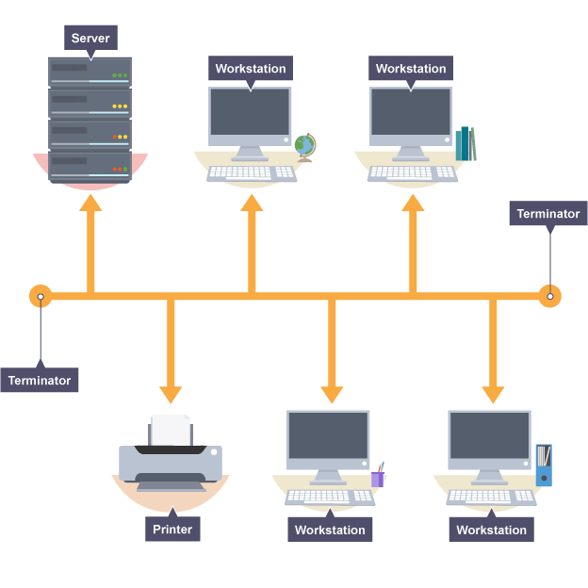
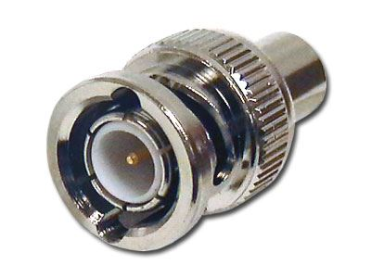
Bus Topology: Terminators
Are resistors that absorb the electrical signal
This stops it reflecting back down the line and causing interference

Slide 122
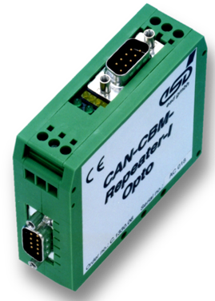
Repeaters
If a line is long (e.g. bus networks & long-distance fibre optic cables), due to attenuation, repeaters are needed to retransmit the signal at full strength
Remember, fibre optic has the lowest attenuation – so repeaters are only needed about every 100km

Slide 123
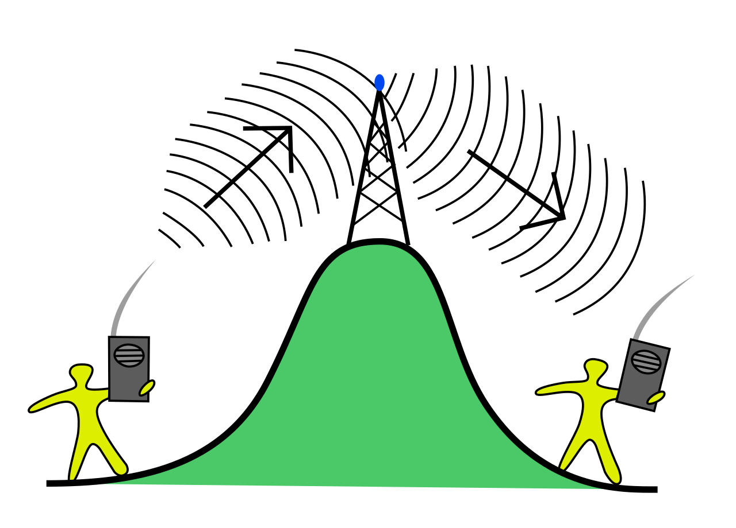
Repeaters
Wireless networking (WiFI, phone towers etc) can also use repeaters – this may be because of distance or obstacles such as walls or hills

Slide 124
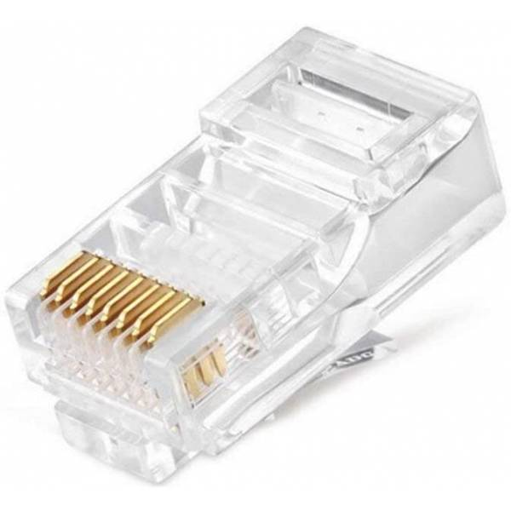
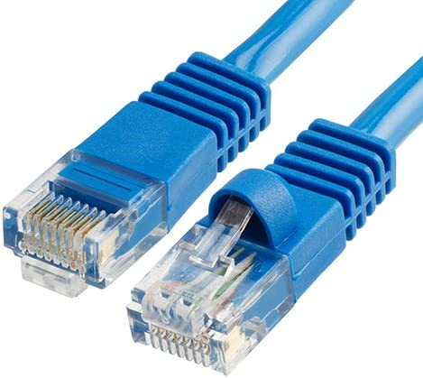
RJ-45 Connectors
Twisted pair cables contain RJ-45 connectors at either end to allow data transfer
One end will plug into the router/switch/hub, will the other end will plug into the device (computer, server etc)

Slide 125

Bridges
A bridge is a device used to connect different LANs together and let them function as if they were a single network
An RJ45 connector on a twisted pair cable from a switch/hub would connect to the ports

Slide 126
Hub
Hubs are almost never used these days – but they might still be mentioned
When a device on a LAN sends data to a hub, it will broadcast it to all other devices on the network – might be suitable in some cases, like video streaming
These days, switches are usually used, since they support unicast, multicast and broadcast

Slide 127
Switch
Stores the MAC (and sometimes IP) addresses of devices on the network
A device will send frames (packets) with a destination MAC address to the switch, which will forward it out of correct port to device based on its MAC address table
Supports unicast, multicast & broadcast

Slide 128

Network Interface Controller/Card (NIC)
Ethernet port will be connected to network interface card (i.e. green circuit board in the picture)
NICs establish initial connection, handle communication (buffering, error correction, interrupts), store the device’s unique MAC address, perform encryption/decryption etc

Slide 129
Wireless Network Interface Controller/Card (WNIC)
Provides the same features as a NIC – but just for wireless communication (e.g. over WiFi, Bluetooth, mobile networks etc)
WNICs contain antenna to transmit/receive wireless signals establish initial connection, handle communication (buffering, error correction, interrupts), store the device’s unique MAC address, perform encryption/decryption etc

Slide 130
WNICs vs NICs
Can you think of devices that have both a WNIC & NIC (in typical cases, these would be combined onto the same board)?
Desktops and some older laptops (though thinner laptops these days often don’t have NICs, since they don’t have an ethernet port)

Slide 131
WNICs vs NICs
Likewise, can you think of a device that would only have a WNIC?
Phones, tablets, home smart devices, thin laptops/notebooks etc
How about a device that might only have a NIC?
Some servers, printers, CCTV cameras, network-attached storage (NAS) devices etc may only support wired connections

Slide 132
Servers
Thinking back to what we’ve learnt, why would servers use wired connections?
Since they could be wired in a star/mesh topology and hence have a range of advantages:
Higher bandwidth
Wired is a more reliable connection
No collisions/interference (in star/mesh)
Higher security
Longer range

Slide 133

Wireless Access Point (WAP)
Central device in wireless LAN is a Wireless Access Point (WAP) – a home router will provide this functionality. Receives & transmits wireless signals via antenna(s)
If a client has a Wireless Network Interface Controller (WNIC), it should be able to connect to the Wireless Access Point (WAP)

Slide 134

Gateway
Acts as a gate to the network – i.e. packets entering or exiting the network will pass through it.
Can convert incoming/outgoing data between different protocols
Can act as a firewall to allow/block packets based on certain criteria

Slide 135

Routers
Technically, routers only route (i.e. direct/forward) packets (data) to the next location
What people call a ‘router’ in a home actually provides the functionality of not only a router, but also a switch, bridge, wireless access point, gateway etc

Slide 136

Routers
In contrast, a router at the bottom of the ocean where e.g. an undersea cable splits in two wouldn’t need these additional features such as being a wireless access point, bridge, switch, gateway etc

Slide 137

Routing Tables
Suppose device 12.0.0.1 wants to send to 14.0.0.1 – can you figure out the path the packet would take?
R2 → R1 → R4 → 14.0.0.1
How about if 12.0.0.1 wants to send to 12.0.0.2?
The switch would realise the device was on the network – the packet wouldn’t leave the network

Slide 138
Routers
Why do you think a typical home router performs the functions of a router, switch, bridge, wireless access point, gateway etc?
Since it makes it easier for the home user – regular people don’t want 5 different devices – they want 1 that does everything
In contrast, a business might have a more complex setup – e.g. many wireless access points, but only 1 router, switch, bridge, gateway etc

Slide 139
IEEE Names for Ethernet & WiFi
The Institute of Electrical and Electronics Engineers (IEEE) write the standards for both. Officially, they are:
Ethernet: 802.3
This is further categorized into 5 generations: standard, fast, gigabit, 10 gigabit and 100 gigabit
WiFi: 802.11
Additional letters come from variations on the spec
The “802” comes from the fact the first meeting was held in 1980/02 (February)

Slide 140

You can see the various WiFi standards the router supports & various other information

Slide 141
Legacy (Old) Internet
As stated, hubs were used about 30 years ago – they would broadcast data to all devices.
A receiving device would then have to check the MAC address in the packet and determine if it was intended for them or not
Bus topologies also work the same way – data is sent along the public bus line, all clients will receive it and have to check if it’s intended for them (based on MAC/IP address)

Slide 142


Collisions
Using a shared medium for transmission (e.g. bus lanes) for data transfer means there can be collisions – i.e. two devices transmitting at the same time, which causes interference and the data to become corrupted
An approach called CSMA-CD (carrier sense, multiple access with collision detection) can be used to solve this

Slide 143
CSMA-CD (carrier sense, multiple access with collision detection)
Check voltage level on wire (no voltage = no activity)
If there is voltage (i.e. message), then wait random time before re-checking
If no activity detected, start transmission
Continuously check for collision
If no collision, continue transmission
If collision, stop transmission & transmit jamming signal to notify other nodes of collision – wait random time and try again

Slide 144
CSMA-CD (carrier sense, multiple access with collision detection)
If two devices send at the same time, why do you think both wait a (different) random amount of time before trying to retransmit?
Since let’s say if both wait 0.01s, there will be another collision – while if 1 waits 0.01s and the other waits 0.05s before rechecking, the chance of collision will be reduced – of course, if there’s another collision, they will both wait a new random amount of time again

Slide 145
Modern Ethernet
Uses switches instead of hubs
Switches store an MAC/IP address table of devices on the network, so they can send packets to specific devices
Switches hence support unicast, multicast & broadcast
Also support full-duplex communication
Switches will have a buffer which can temporarily store packets when under high load

Slide 146

Modern Ethernet: Collisions?
If using full-duplex links, are collisions possible?
No – since full-duplex provides data transfer in both directions – if A is connected to B, there will be a dedicated wire supporting data transmission from A → B and another dedicated wire supporting transmission from B → A

Slide 147
Give a simple description of a hub, switch, router, bridge, gateway, repeater, wireless access point, (wireless) network interface card:
Hub: connects devices on a network and broadcasts all packets
Switch: connects devices – supports unicast, multicast, broadcast by using a MAC address table and sending data out the correct port
Router: routes packets between devices/networks by sending packets to next hop, based on routing table
Bridge: connects two network segments into a single network
Gateway: entry/exit point of a network – connects networks of different protocols; can act as a firewall
Repeater: retransmits signal at full strength to prevent signal loss due to attenuation

Slide 148
…continued…
Wireless access point: allows devices to connect wirelessly; has antenna to receive/transmit signals
Network interface card: contains Ethernet port, establishes initial connection, communication (buffering, error correction, interrupts), stores MAC address, performs encryption/decryption etc
Wireless network interface card: as above, but no Ethernet port & supports wireless connections instead

Slide 149
How are collisions handled on a bus network – is this an issue on modern bus networks?
Check voltage level on wire (no voltage = no activity)
If there is voltage (i.e. message), then wait random time before re-checking
If no activity detected, start transmission
Continuously check for collision
If no collision, continue transmission
If collision, stop transmission & transmit jamming signal to notify other nodes of collision – wait random time and try again

Slide 150

9618 AS
Unit 2
Internet Data Transmission

Slide 151
Class Overview
Internet vs world-wide web
Internet Service Providers (ISPs)
Packet-switching vs circuit switching – use cases, advantages and disadvantages

Slide 152
WWW vs Internet
WWW = World Wide Web – a collection of webpages linked together and accessed via the HTTP(S) protocol
Internet = inter-network – the worldwide connection of devices and infrastructure (cabling, satellites, routers etc) – communicates over IP and any digital data can be sent – webpages, media, emails, files, programs, text etc
So the Internet is a superset, containing the World Wide Web…

Slide 153
Internet vs WWW
Clients
Servers
IP/TCP/UDP
Infrastructure/
Cables
Emails
Files
SSH/Telnet/
Webpages via HTTPS

Slide 154
Internet Infrastructure
The Internet can be considered a huge WAN
It was never designed as a ‘whole’ – it simply grew naturally (with millions of people adding servers & even more acting as clients)

Slide 155
Internet Service Provider (ISP)
The Internet wasn’t officially designed, however it developed into a hierarchical model
Access/Tier 3 ISPs: allow an individual/business to connect to regional ISP
Regional/Tier 2 ISPs: connect local access ISPs & provide national/regional coverage
Global/Tier 1 ISPs: provide global backbone (undersea cables, satellites etc)
Note: many ISPs will fall into multiple categories – e.g. China Mobile, AT&T and BT are all 3

Slide 156
Internet Service Provider (ISP)
In China, there are only 3 ISPs (China Mobile/Telecom/Unicom) – these 3 are massive companies, hence provide services from local (tier 3) to global (tier 1)
In contrast, in the UK, there are “more than 200” different ISPs – so most of these will be tier 3 (local), less will be tier 2 (regional/national) and some will be tier 1 (global) – a few will be all 3 tiers (BT, Vodaphone etc)

Slide 157
Internet Service Provider (ISP)
Let’s see how a packet might be routed from someone on one ISP, to someone on a different ISP
Note: don’t get confused about “stage 1-3” – that isn’t talking about the “tier 1-3” we mentioned earlier

Slide 158

Packets sent to your ISP’s local router in your city/region

Slide 159

Packets could be routed via own ISP’s cabling/shared cables to different city if possible…if not, we need stage 3…

Slide 160

IXPs are locations where multiple ISPs meet – the packets can be swapped from one network to another

Slide 161

Tier 1 – Global Backbone

Slide 162


Slide 163
Undersea Cable Maps
These undersea cable maps come from https://www.submarinecablemap.com/ - you can check it out, if you’re interested

Slide 164

Undersea Cables
The 3 gold circles contain the actual fibre optic cables – the rest is all protection – why do you think so much is needed?
Extremely high pressure at bottom of ocean, to prevent leaks…even some unexpected reasons…

Slide 165


Slide 166
Access in Remote Locations
Surprisingly, even many small islands (with populations of a few thousand or less) are connected with fibre – of course, there are still some that aren’t
For example, Antarctica isn’t connected by fibre
So how can people living/working in these areas access the Internet?
Using satellites (though the speed is slow & expensive – it supposedly costs $3 to send an email, on Antarctica)

Slide 167
Routers
Do you remember what the function of a router is?
To look at the destination IP address, then forward the packet to the next hop, based on its routing table

Slide 168
Routers
Suppose device 12.0.0.1 wants to send to 14.0.0.1 – can you figure out the path the packet would take?
R2 → R1 → R4 → 14.0.0.1
How about if 12.0.0.1 wants to send to 12.0.0.2?
The switch would realise the device was on the network – the packet wouldn’t leave the network

Slide 169
Routers & Buffers
Routers – like (W)NICs, sound cards, GPUs etc – have buffers
A buffer is a temporary storage space to hold data, as other data is being processed/transmitted
Imagine a backbone router has a maximum bandwidth of 1Gb/s – what happens if it receives 1.1Gb/s in a second? We don’t want to drop those packets – so we’d store that extra 100Mb in a buffer, until the router is able to process is

Slide 170

Routers & Buffers
The buffer stores data, until the router is available to process it

Slide 171
Routers
Where are routers placed?
Home/office
At access/regional/global (tiers 3 → 1) ISPs
Anytime a cable splits – e.g. when an undersea cable reaches land and it splits, with different parts going to different regions/countries

Slide 172

Routers
Not required for exam, but we can use the tracert (trace route) command to list the routers the data travelled via and websites like https://ipinfo.io to get information about those IPs – some IPs hidden for privacy
tracert bing.com

Slide 173

Routers
Does anyone know what the 192.168.X.X IP addresses are?
This are private IP addresses – hence will be the IP address of our router in the office, then perhaps another in the school

Slide 174

Routers
Where/what do you think the 3rd hop is?
We can see it’s a router owned by the ISP in our city

Slide 175

Routers
Using the baidu.com trace we ran, we can look at the last hop and notice it’s in Beijing, which makes sense

Slide 176

PSTN (Public Switched Telephone Network)
Calls would be sent along telephone line to an exchange

Slide 177


PSTN (Public Switched Telephone Network) - Exchanges
Assume someone in Manchester wanted to call someone in Melbourne – the switch operator would literally plug the cable into the London port – and an operator there would plug it into another port and so on…until you eventually got to Sydney, who could then route it to Melbourne

Slide 178

Modern Telephones
Note: modern landline systems don’t actually work like this – everything is digital and most phone calls travel along fibre optic cables
Even landline phones themselves are uncommon in most homes these days

Slide 179
PSTN – Old Internet
When the Internet was first getting popular in the 90s/2000s, there wasn’t the millions of km of fibre optic wires we have today
Instead, data was sent over the existing telephone line infrastructure, which had existed for the past 100 years
There was a problem – telephone lines transmitted analogue signals, while the Internet operated digitally – a modem was required – a device used to convert between analogue to digital and vice-versa

Slide 180

PSTN – Old Internet
This would be a typical setup – however it was slow and you could often only use the Internet or phone – not both
For example, you might literally have to turn off your router, if someone called you
Modem would convert between analogue phone signals & digital Internet signals
The modem is the big device – the other thing is the phone/Internet splitter – THIS particular setup allows Internet/phone to operate simultaneously on different frequencies

Slide 181
Packet Switching & Circuit Switching
There are two ways we can transmit data from a source to a destination – we have looked at both briefly, but let’s compare them in more detail
Packet-switching (what routers use)
Circuit-switching (what old telephone system used)

Slide 182
Features of Packet Switching
Data is sent without a connection being established between the sender & receiver – this means establishing the connection is fast, but the receiver may be unreachable – device off, network error etc
Routers forward packets onto the next hop based on their routing table
Data – say an image – will be split into many smaller packets (usually not larger than 1460 bytes) – packets may travel different routes or arrive out of order – they will then be re-ordered at the destination (if using TCP)

Slide 183
Packet Switching: Advantages
Doesn’t require dedicated infrastructure for each user – many people can share the same e.g. fibre optic cables – cheaper and more scalable
As such, there’s a better utilisation of hardware
Can be faster – packets can be sent along the faster route (hopefully)
No connection required (connectionless) – lower initial delay (latency)
---
Reliability can be built-on top – e.g. a higher level protocol like TCP which will resend packets that don’t arrive and reorder them upon arrival

Slide 184
Packet Switching: Disadvantages
Packet loss – some packets might not arrive at destination (misconfigured network, broken router/cabling, full buffers)
Packets can arrive in wrong order
Variable latency – packets travelling different routes will take different time – might have to wait for all to arrive to reassemble
Header overhead – small amount of extra data needed in every packet header (source & destination IP, packet length, version 4/6, checksum, time-to-live (TTL) etc)
Some of these issues can be handled though – for example, rerouting & higher-level protocols like TCP helps to ensure all packets should arrive

Slide 185

Features of Circuit Switching
A physical link between sender & receiver is required – this could be with someone on the other side of the world
Connection must be established before communication can begin
Channel is dedicated for only those 2 users for duration of communication

Slide 186

Leased Lines
Because a dedicated connection was required, if no connections were available, someone might not be able to connect
As a result, a company might want to rent a permanent line – i.e. a leased line

Slide 187
Circuit Switching: Advatanges & Disadvantages
Ensures receiver is reachable before sending
Dedicated channel required (can be an advantage (reliable, high bandwidth) or disadvantage (wasteful))
Suitable for long, continuous communication (e.g. phone calls)
Data will arrive in correct order
System has many backup generators – you can still make phone calls in an emergency (e.g. calling emergency services in a flood
If all channels being used, you won’t be able to connect
Higher cost (due to requirement of dedicated channels)
Higher initial latency due to ensuring receiver is available

Slide 188

Question
A difficult question from June 2015, paper version 12

Slide 189


Slide 190
Briefly explain the difference between the Internet and WWW:
The Internet is a worldwide network of interconnected devices, routers, cables etc – packets routed based on IP addresses and supports WWW, email, media streaming, peer-to-peer downloads etc
In contrast, the world-wide web (WWW) is simply the collection of all interconnected web pages that can be accessed over HTTP(S)

Slide 191
Explain how packet switching and circuit switching route packets to the correct destination
Packet switching: data split into packets and forwarded by routers to next device based on their routing table until the packets arrive at the destination. Packets are sent without connection being established, travel different routes and may have to be reordered upon arrival
Circuit switching: physical, dedicated cable link connected between sender and receiver required before communication can begin - data will be sent as a continuous stream. Previously involved humans manually plugging in/unplugging (switching) cables at switching office, but is now automated

Slide 192
List some advantages/disadvantages of packet and circuit switching
Circuit switching: reliable/dedicated/high bandwidth connection, suitable for long continuous communication, data arrives in correct order, backup generators for emergencies, all channels could in use, expensive due to dedicated connections, higher initial latency
Packet switching: fast, reliable due to rerouting, shared transmission mediums = cheap/better utilisation of hardware, lower initial delay, some packet loss, packets can arrive out of order, variable latency, header overhead

Slide 193

9618 AS
Unit 2
Applications that make use of the Internet

Slide 194
Class Overview
Internet vs World Wide Web
Cloud computing – advantages & disadvantages
Private and public clouds
Bit streaming – realtime & on-demand

Slide 195
Internet vs world-wide web (WWW)
Do you remember the difference between the Internet and world-wide web (WWW)?
Let’s recap…

Slide 196
WWW vs Internet
WWW = World Wide Web – a collection of webpages linked together and accessed via the HTTP(S) protocol
Internet = inter-network – the worldwide connection of devices and infrastructure (cabling, satellites, routers etc) – communicates over IP and any digital data can be sent – webpages, media, emails, files, programs, text etc
So the Internet is a superset, containing the World Wide Web…

Slide 197
Internet vs WWW
Clients
Servers
TCP/UDP
Infrastructure/
Cables
Emails
Files
SSH/Telnet/
Webpages via HTTPS

Slide 198
Cloud Computing
Cloud computing is the provisioning of computing services via the Internet
Clouds can be either private within the company or public like (AWS, Baidu, Azure, Alibaba, Tencent, Google etc)

Slide 199


Slide 200
Private Cloud Computing: Categories
For the private cloud option, there are 3 choices
Organisation creates and manages their own on-site cloud
Organisation outsources to a 3rd party to create & manage on-site cloud
Organisation outsources to a 3rd party to create & manage off-site cloud
Which would be the most/least “private” of these options?
1 -> 3 is from most to least private

Slide 201
Private Cloud Computing: Categories
“Organisation outsources to a 3rd party to create & manage on-site cloud”
Why would a company do this?
If the company is small, they won’t have a specialised team that has the skills/time to create & manage the system – so they can outsource this to a 3rd party, but still get benefits of an on-site cloud (possibly more secure, lower latency, more customisable)

Slide 202

Public Cloud
In contrast, for public cloud computing, the user/company only has 1 choice – to use the cloud provider’s infrastructure
In this situation, customisation is more limited/not possible/expensive

Slide 203

Cloud Services
Services offered by cloud providers can be overwhelming
Some common ones are file storage & delivery, databases, processing etc

Slide 204
Cloud Services
Cloud services can be provided by a single or large number of servers – we can group the services offered into 3 categories:
Infrastructure provision – renting hardware directly
Platform provision – OS, different environments
Software provision – Google docs, Baidu NetDisk/OneDrive etc
These are more commonly called IAAS, PAAS, SAAS – e.g. “infrastructure as a service”

Slide 205

IaaS, PaaS or SaaS?
A game development company wants to store the latest code with a version control system like Github, so all developers can access and work on the same code
SaaS

Slide 206

IaaS, PaaS or SaaS?
An app company wants to test their latest app on every Android and iOS version
PaaS – the company could rent access to different mobile operating systems

Slide 207

IaaS, PaaS or SaaS?
An academic department wants to rent hardware to run a computationally-intensive scientific simulation and artificial intelligence project
IaaS – they could rent the required CPU, GPU, RAM, storage capacity etc they need for a short period, without having to buy it

Slide 208

Cloud Services
While SaaS requires the other two, you are often sandboxed in – e.g. with Baidu Netdisk or Google docs, you can’t actually access the operating system/configuration, like you can with IaaS/PaaS

Slide 209
Cloud Advantages
Remote access – employees can access files from anywhere
Collaboration – employees can work on same files simultaneously
Can be used as a remote backup
Big cloud company might have better security than a system we could make ourselves
“Reduces complexity” if a public cloud – someone else handles it

Slide 210
Cloud Disadvantages
You are storing your data with another company – you have to trust them & their security/privacy standards
MUCH more expensive than traditional servers
Some software can’t be run as effectively when distributed across multiple servers (e.g. databases)
Less customisable/control compared to having your own servers

Slide 211
Alternative to Cloud
An alternative to the cloud is a VPS (virtual private server) – in this situation, you are renting (part of) a specific server
In contrast, in the cloud, you are paying for usage – you could be using 1 server or 1,000 – the cloud provider will automatically create/remove servers as your demand changes (though this can be 100s of times more expensive than just renting/buying the hardware yourself)

Slide 212
Cloud vs VPS
Highly-scalable due to being able to spin-up new instances automatically when demand surges
Variable-pricing can result in huge bills (e.g. a small error causing an infinite loop or (D)DOS attack costing $10,000 in 24 hours)
Pay-as-you-go – if you only need for 1 hour, that’s all you pay
You have fixed-resources, so can’t scale up at a moment’s notice
Fixed-price can be reassuring
More customizable than cloud
Shortest contract would usually be 1 month

Slide 213

Bit Streaming
Do you know what a stream/streaming is (either in computer science or geography)?
Accessing a constant flow of data – e.g. a live video, phone call, watching a movie, listening to music etc. Unlike a regular download, a stream is of unknown/possibly indefinite length

Slide 214


Bit Streaming: On-Demand vs Realtime
On-demand: streaming from a source that already exists
Realtime: streaming from a live source
Can you think of some examples of each?
On-demand: pre-existing media – YouTube, Soundcloud, Netflix etc
Realtime: live sports, Twitch, radio etc

Slide 215







Which are on-demand & which are realtime?

Slide 216
On-Demand:
Media files stored on server and converted to a streaming format
Can pause, rewind, fast-forward etc
Often better quality – buffering makes short connection drops less of an issue
Realtime:
Event is captured in real-time and live media sent
(Might not) be saved on server – hence, once it’s been sent out, it has “gone” and can’t be rewatched, paused etc. Packet loss over UDP can be an issue – parts of video/audio will be lost
[in reality, the user’s media player could e.g. keep last 30 minutes of played media on disk to allow for pausing, rewinding etc]

Slide 217

Bit Streaming
Media player requests data from media server & stores in it buffer
Media player plays video as it arrives in the buffer
If buffer reaches high-watermark level, media player tells server to stop sending – if buffer hits low watermark level, media player tells sever to resume sending
Diagram is slightly wrong – high & low-watermark should be switched based on data flow direction

Slide 218

In 1 second: 122.1KiB inbound (1 * 10⁶) / (8 * 1024), 36.6KiB outbound – double for 2 seconds
Each second, buffer is filled with 85.4KiB – hence will take ~9.4s to reach high watermark
When incoming transmission stops, 36.6KiB will leave the buffer per second – hence will take 21.8s to drop to low watermark

Slide 219
Bit Streaming Question
You are designing a media player to play videos with a resolution/frame rate of 1920x1080p30 and a colour depth of 24 – assume with compression, the file size reduces by 50x.
You want to stop requesting data when you have 2 minutes of video stored in the buffer and start requesting data when there is only 30 seconds remaining in the buffer – what size should you make the high & low watermark level?
1 second = (1920 * 1080 * 30 * 24) / (50 * 8 * 1024²) = 3.56MiB
Hence HW = 120 * 3.56 = 427.15MiB ; LW = 30 * 3.56 = 106.79MiB

Slide 220
Bit Streaming – Advantages & Disadvantages
Can play immediately without waiting for whole file to download
Don’t need to store large files on own device
Harder to pirate (saving streams to files is harder)
Requires Internet connection
Can buffer/lag on slow connection/high resolution video
Uses lots of bandwidth (especially if e.g. streaming same song 100 times…better to download it once)

Slide 221
Define cloud computing
The provisioning of computing services via the Internet
List some advantages and disadvantages of a company using cloud computing to host their files/software?
Remote access, collaboration, remote backup, better security, “reduces complexity”
Security/privacy concerns/loss of control of data, expensive, some programs can’t be distributed easily/at all, less customisable/control

Slide 222
List some reasons why someone might choose a public vs private cloud and vice-versa:
public: requires less expertise and doesn’t require expensive setup/hardware costs (more expensive long-term costs though), might be more secure than own solution
private: more private/secure/have more control, cheaper in long-term, more customisable (e.g. specific hardware/configurations)

Slide 223
Explain the difference and advantages/disadvantages of on-demand vs realtime bit streaming
On-demand: media created in past, is converted to a streaming format and streamed to user – can pause/rewind/fast-forward etc, network should support high-quality playback due to pre-buffering, requires lots of storage to store content
Realtime: live playback of event – can’t pause/rewind/fast-forward, dropped/unsent packets = can’t play that part of stream

Slide 224

9618 AS
Unit 2
IP Addressing

Slide 225
Class Overview
IPv4 addresses & format – valid & invalid examples
IP history
Network ID & Host ID
IP Classes
Classless Interdomain Routing
Subnetting
Advantages & disadvantages of each

Slide 226

IP Addresses
IP = Internet Protocol
When first built, a public IP address would uniquely identify every device in the world
Effectively, it is like a house address, but uniquely identifying a device on a network

Slide 227
IPv4
IP version 4 was planned in the 1970s and introduced in 1982 – at this point, the Internet was just used for the military & universities – they didn’t believe it would ever grow to the size it did
Do you know the format of/how many bits are used for IPv4 addresses? Hence how many different IPv4 addresses are there?
32 bits, written as 4 groups of numbers from 0-255 – e.g:
192.168.0.1
2³² = 4,294,967,296 (approx. 4.3 billion) addresses

Slide 228


Slide 229
IPv4
Can you see a problem with having about 4 billion IP addresses?
There are nearly 8 billion people…most people now have Internet access and many people have multiple devices connected to the Internet (laptop, desktop, tablet, phone, tv, car, games console, even fridges etc)
So IPv4 wouldn’t be able to uniquely identify all devices – so changes had to be made, like subnetting, dynamic & private IP addresses

Slide 230
IPv4
Why do you think they choose to use 32 bits to represent IP addresses when IPv4 was created?
As mentioned, since it was never expected that more than 4 billion would be needed
Internet speed was slow/data was expensive – both the source & destination IP address are sent with every packet, so you wanted to keep packet size as small as possible
[the 2nd point isn’t that relevant – since even using just 8 extra bits would give you 2⁴⁰ = 1,099,511,627,776 addresses]

Slide 231
IPv4 Format
Comprised of a network ID & device ID
For example, a company could buy the network ID 200.200.200 – that’s 24 bits
That gives them 8 bits remaining for the device ID
Valid IPs for devices would hence be 200.200.200.0 to 200.200.200.255
Hence, with 8 bits for the device ID, they would have 256 different IP addresses
[note: the split could be any values that add to 32 – here I just chose 24 bits for the network ID and 8 for the client]

Slide 232
IPv4 – Valid or Invalid?
1234.57.93.4
185.92.2.220
256.58.39.110
174.8.2.92.1
Invalid: 1234 > 255
Valid
Invalid: 256 > 255
Invalid: uses 5 groups

Slide 233

Routers
Device ID 0 on the network is usually used for other purposes, so routers will often (but not always) have device ID 1
A router will inspect the destination IP address of each incoming packet in its routing table and forward the packet to the next best hop

Slide 234
IPv4: Separating Network ID from Device ID
We said that part of an IP address represents the network – while part represents the device. There have been 3 ways used to achieve this:
IP classes
Classless Inter-Domain Routing (CIDR)
Subnetting

Slide 235

IPv4 Classes
“IPv4 addresses classes really don't exist anymore, and have been deprecated since 1993”. (though the exam may ask about them…)
For example: 110 00101110 11011101 10001 10111100
What class would this be?
Class C – since the IP address starts with 110

Slide 236
IPv4 Classes
Why do we need up to 3 bits for the class identifier? Why not just say class A = 0, B = 1 and C = 01
To prevent ambiguity – i.e. if a an IP started “01”, that could be either be a class A or class C class
Recap: What text compression technique do we also need to make sure patterns start with a unique series of bits?
Huffman Coding

Slide 237


Slide 238
IPv4 Classes: Number of Net IDs & Device IDs
Remember each IP has to be unique – how many different netIDs are there in class A?
Only 2⁷ = 128 – i.e. there were only 128 class A networks for all governments/companies in the world – each class A network could have 16,777,216 devices

Slide 239
IPv4 Classes: Number of Net IDs & Device IDs
Class | Number of NetIDs | Number of Device IDs
A | 128 | 16,777,216
B | 16,384 | 65,536
C | 2,097,152 | 256
Can you see any problems with this allocation?
As noted, only 128 class A networks can exist – a bigger issue, however, is that only 16,384 (2¹⁴) different class B’s can exist worldwide – most medium businesses, schools, hospitals etc would want this class – but there weren’t enough

Slide 240
IPv4 Classes: Number of Net IDs & Device IDs
Class | Number of NetIDs | Number of Device IDs
A | 128 | 16,777,216
B | 16,384 | 65,536
C | 2,097,152 | 256
Suppose a company has 257 devices – what do you think might happen?
They could have bought 2 class C’s, but this would make configuration difficult – so often they would simply buy a class B – but then they’d have more than 65,000 addresses that were unused and that no one else could use (and remember there are only 4.3 billion IPv4 addresses)

Slide 241

IPv4 Classes: Unused Device IDs
Suppose a small company has 150 computers, but they will be on 7 different LANs (different buildings, departments etc)
They will need to buy 7 class C networks, which would mean 1792 addresses – but since they only have 150 computer, 1642 of those addresses are wasted

Slide 242
IPv4 Classes: Unused Device IDs
So, to try and solve this problem of wasted IP addresses with a class-based IP system, a new approach was introduced…

Slide 243

Classless Inter-Domain Routing (CIDR)
Aimed to solve problem of inflexible split (i.e. only 3 classes) between network ID and host ID (device ID)
Adds 8 bit suffix to the IP
Suffix specifies how many bits are for the network ID
The remaining bits (of the 32 bit IPv4 address) would be for the host ID
Below we see 21 bits for network ID, hence 11 for host ID
Note how CIDR also doesn’t waste 1-3 bits for specifying the class

Slide 244
Classless Inter-Domain Routing (CIDR)
Note: CIDR IP addresses are compatible with original class-based IP system – by simply setting the suffix to 8, 16 or 24 respectively
e.g. note how class C uses 3 bits (110) for the class identifier and 21 for the net ID – i.e. 3 + 21 = 24 bits – we could keep the 21 bit net ID the same and set the leading 3 bits to 0

Slide 245

Subnetting
Another approach – and the one currently used today is subnetting – you can run ipconfig /all and you will notice the subnet mask for the network
Let’s see how it works…

Slide 246
Subnetting
Again, a 32-bit IPv4 address is split into a network ID and host ID
A subnet mask is used to determine if a bit corresponds to the network or host ID
A 1 means the bit corresponds to the network – a 0 means it corresponds to the host
i.e. 255.255.255.0 = 1111111 11111111 11111111 00000000 = 24 bits for net ID; 8 for host ID
So an IP of 70.152.34.55 would mean the network 70.152.34 and device 55 on this network

Slide 247
Subnetting
Common subnet mask are 255.255.255.0 and 255.255.0.0
The first is much more common worldwide than the latter – why do you think that is?
Since the first subnet mask provides 8 bits for the host ID (256 devices), while the latter provides 16 bits for the host ID (65,536)
Other than big companies/governments etc, most people (e.g. in homes) don’t need networks with 65,536 devices. Using an 8-bit host ID means we can have more networks (since 24 bits are available for the network ID)

Slide 248

Subnetting
Subnetting is used to break a big network into multiple, smaller subnets – for example, imagine you are a company and have different switches/departments
e.g. You may not want the customer service department to be on the same network as the research & development department for various reasons we will see later…

Slide 249
Subnetting
For example, suppose we have 8 bits for the host ID – we could use 3 of these bits to represent a subnet and 5 to represent a device ID
That would give us 8 networks with 32 devices on each, rather than having 1 LAN with 256 devices on it

Slide 250

Subnetting
Here you can see how the number of subnets and possible hosts on each change as the subnet mask changes

Slide 251


Slide 252
Subnetting
The subnet mask doesn’t always have to be split at position 8, 16 or 24 – suppose we have a network that will have a maximum of 1000 devices – how many bits should we use for the network ID vs host ID, hence what would be the subnet mask?
2¹⁰ = 1024 – hence choosing 10 bits for the host ID would be good
Our subnet mask would hence be:
11111111 11111111 11111100 00000000
255.255.252.0

Slide 253
Subnetting
Suppose we have the IP address 27.78.103.250 and subnet mask 255.255.252.0 – what would the network id and host ID be
IP | 00011011 | 01001110 | 01100111 | 11111010
Subnet mask | 11111111 | 11111111 | 11111100 | 00000000
So really, if representing in denary, this is like saying the device is on network 27.78.100 and the device ID is 1018 (1111111010)
So things can get a bit complex for humans if the subnet mask doesn’t split on an 8-bit boundary – you won’t need to do this in the exam, but you need to know the split position could be anywhere

Slide 254

Subnetting
Have a go:
https://www.iptp.net/en_US/iptp-tools/ip-calculator/

Slide 255

The /[number of bits for network ID]
is called CIDR notation
Instead of using CIDR notation, what would the equivalent subnet mask be?
255.255.255.0

Slide 256
Would 192.168.2.0 be a valid IP for this network?
No – since the first 24 bits are the net ID, hence can’t change
How about 192.168.1.2?
Yes – since only the host ID changes and is in range 0-255

Slide 257
Subnetting Advantages & Disadvantages
Let’s see the advantages and disadvantages of breaking a single network down into multiple subnetworks (subnetting)

Slide 258
Allows greater utilisation of IP space – i.e. less wasted IP addresses
Makes networks easier to organise & maintain for large networks – though does require initial expertise to setup
Improves security – i.e. different firewall rules/levels of security based on the subnet
Network separation: different departments (e.g. finance and research) don’t have access to other network/files. Hackers/malware can also (hopefully) be contained to single subnet
Improves efficiency by breaking down big, busy networks – this however does make it slightly more expensive, since additional routers are required (though for a company, this cost is insignificant)

Slide 259
Questions
What do the letters “IP” stand for?
Internet Protocol
What is an IP address used for?
To uniquely identify a device on a network – hence allowing it to receive packets (communication) from other devices via a series of routers
An IP address consists of two parts: a ________ and ________
Network ID & Host ID

Slide 260
Questions
Describe the format of an IPv4 address:
32 bits
4 groups of 8 bits each
Each group can represent denary number 0-255
Groups separated by dot/full stop/period “.”

Slide 261
State whether these IPv4 addresses are valid – if invalid, give a reason:
80.47.328.204
Invalid: 328 is greater than 255, the max allowed value
28.243.102.75
Valid
123.78.1.0.2
Invalid – 5 groups, not 4
94:82:185:230
Invalid – doesn’t use full stop “.” as group separator

Slide 262
What 3 approaches were used to break an IP address into the network & host ID?
IP classes
Classless Interdomain Routing (CIDR)
Subnetting

Slide 263
How many IP classes are there – what are some problems with them?
3 classes – main problem is that network/host ID is at fixed position, hence people won’t use all the host IDs they are allocated = low IP address utilisation
How does CIDR solve this and what is the notation like?
The network/host ID split can be at any bit position – hence networks can be allocated only the number of host IDs they need. For example, 100.110.120.130/24 means 24 bits are used for the network ID, while 8 bits would be for the device ID

Slide 264
Explain what the IP address 11.22.33.44 and subnet mask 255.255.0.0 mean in terms of the network/device ID
The first 16 bits represent the network ID; the last 16, the host ID. Hence the network is 11.22 and the valid range of device IDs would be from 11.22.0.0 to 11.22.255.255

Slide 265
List some advantages/disadvantages of breaking a network down into smaller subnets:
greater utilisation of IP space – due to flexible network/host split
easier to organise & maintain – since less devices on each network
improved security – e.g. firewall rules, access rights
network separation - privacy
threat containment – hackers/malware harder to traverse network
improves efficiency – since you don’t have 1 router with 100s of devices
requires network admin to setup
more expensive due to requirement of routers for each subnet

Slide 266

9618 AS
Unit 2
IP Addressing – Part 2

Slide 267
Class Overview
Public & Private IP addresses
Ports
Network address translation (NAT)
Static & Dynamic IPs
Dynamic host control protocol (DHCP)

Slide 268
Combating Shortage of IPv4 Addresses
As stated, IPv4 uses 32 bits, hence only has about 4.3 billion IPs available – to combat this shortage, a few approaches were used:
Subnetting
Private IPs & NAT (network address translation)
Dynamic IPs (using DHCP)
We have looked at subnetting, so let’s look at the other two…

Slide 269
Network Address Translation (NAT)
Rather than each user having a public IP address that had to be globally unique, we could:
Give the network router a globally-unique IP address
Give devices on the network a private IP address that the router that only had to be unique for that network
This is why if you look in a device’s connection settings (in a GUI or command like ipconfig /all), you will see a private IP address like 192.168.0.1

Slide 270

What would the default subnet mask for each of these address ranges be? Which can have the most devices?
255.0.0.0
255.240.0.0
255.255.0.0
These private address ranges are hence listed from having most → least available device IDs

Slide 271

One screenshot was taken from connecting to the classroom WiFi – one was taken by connecting to the schoolwide WiFi – which do you think was which & why?
Left is schoolwide network – 10.X.X.X IPs have more host IDs than 192.168.X.X networks
We’ll look at DNS in more detail later…

Slide 272

Public IPs – not NAT
Each end device has globally unique IP = bad

Slide 273

Router has public, globally-unique address
Devices have private addresses unique to that network only

Slide 274

Ports
When a device receives data, do you think it would be able to tell what process (application) that data is for?
No – this is what ports are used for – they specify the process the data is for
An analogy would be that an IP address is the building…while the port would be the specific room number/person’s name

Slide 275


Ports
Note: ports can refer to hardware ports – LAN/ethernet ports, USB ports etc
In THIS case, however, the ports we are referring to aren’t actually a physical object – they are effectively just an ID number so data can be sent to the correct process

Slide 276
Ports
So:
hardware ports: used for input to/output from device
software ports: specifies the process the data should be sent to on a device

Slide 277
Certain ports are usually used for specific protocols – e.g.
If a server has a web server, it will (usually) be running at port 80/443, email at 25/110/143 etc
When you type “example.com”, your browser actually appends the port itself – e.g. example.com:443
Port Numbers & Protocols
Port Number | Usage
20 | File Transfer Protocol (FTP) Data Transfer
21 | File Transfer Protocol (FTP) Command Control
22 | Secure Shell (SSH)
23 | Telnet - Remote login service, unencrypted text messages
25 | Simple Mail Transfer Protocol (SMTP) E-mail Routing
53 | Domain Name System (DNS) service
80 | Hypertext Transfer Protocol (HTTP) used in World Wide Web
110 | Post Office Protocol (POP3) used by e-mail clients to retrieve e-mail from a server
143 | Internet Message Access Protocol (IMAP) Management of Digital Mail
443 | HTTP Secure (HTTPS) HTTP over TLS/SSL

Slide 278
Here you can also see both the local (client) and remote (server) IP addresses & ports
For example, you can see my anti-virus, Chrome, Edge, OneDrive, QQ etc

Slide 279
Network Address Translation (NAT) - Question
Suppose my private IP is 192.168.0.1 – if I send a request to a server, how does it know where to respond (since this IP is private and not unique)?
When packets pass through your router, your router changes the source destination from being your device’s private IP, to being the router’s public IP
A record mapping the private IP:port to the public IP:port is then added in the router’s NAT forwarding table, so that when the router receives a packet from the server, it knows which private IP & port (process) to send it to

Slide 280

User wants to send a request to web server

Slide 281

Router changes packet’s source IP address & adds IP:ports to its NAT forwarding table
Note: routers performing NAT have both public & private IPs

Slide 282

Server sends response, using router’s public IP address and specified port

Slide 283

Router then maps the incoming packet’s public IP:port to the private IP:port and sends it to the correct device on the network

Slide 284
Static vs Dynamic IP Addresses
The final method to solve the shortage of IPv4 addresses is by using dynamic IP addresses – just by the words “static” & “dynamic”, can you guess what this might mean?
Static IP addresses: fixed, don’t change
Dynamic IP addresses: assigned by ISP/router using DHCP (Dynamic Host Configuration Protocol) – a device’s IP can change

Slide 285
Static IP Addresses
What kind of devices might require a fixed-IP address?
Servers – web, file, email, database, print etc
What would happen if they did change?
Suppose an email server has an IP of 12.34.56.78 – if this IP address changed, the packets would no longer arrive at the correct server.
Note: there are protocols like DNS that allow IP records to be updated, since sometimes we have to
This would be like sending a letter to someone – you don’t want them to move house every day

Slide 286
Static IP Addresses
When talking about servers, static IPs can be considered more secure – why do you think that is?
Assume if the IP address of a popular website now points to a random user’s machine and millions of people are trying to access it – the person could instead send them a malicious version of the website to steal their account details (pharming) or just send them malware directly
So if an IP is assigned to a specific company and never changes, users can have more trust that it is legitimate

Slide 287
Dynamic IP Addresses
For other situations – e.g. personal devices – we don’t need a permanent IP address (in fact, for privacy/security reasons, it’s better if we don’t)
Afterall, assume you use your computer for 1 hour per day and the other 23 hours it’s turned off – if every device had a fixed IP, no one else would be able to use that IP, even when it’s not needed

Slide 288
Dynamic IP Addresses
There will usually be two situations where dynamic IPs are used
Your router will ask for a public dynamic IP from your ISP’s DHCP server when it is turned on
Individual devices will ask for private dynamic IPs from your router

Slide 289
DHCP (Dynamic Host Configuration Protocol)
The DHCP server (a home router includes this functionality) is responsible for:
Assigning unique IP addresses to devices that request one
It does this by storing the valid IP range and list of currently used IPs

Slide 290
DHCP Lease
A device will ask the DHCP server for an IP and the DHCP server will grant them one for a period of time – usually, this will be between 1 hour to 1 week (let’s assume 8 hours, to make the maths easier)
When half the lease time has passed, if the device is still online, it will ask the DHCP server if it can extend the lease
If the DHCP server is unavailable, the requesting device will wait half the time and try again – e.g. if the initial lease is 8 hours, the device will wait the following time to try and renew the lease: 4 hours → 2 hours → 1 hour → 30 minutes → 15 minutes → 7.5 minutes etc…if not renewed in time, the IP will become available for another device

Slide 291
DHCP Lease
We can see here, my device was granted a 2 hour lease (11:30 to 13:30)
After 1 hour, the lease would try to be extended

Slide 292
DHCP Lease
Routers are usually assigned longer leases by the ISPs DHCP server than devices are assigned by the router’s DHCP server – why do you think that is?
People turn off devices much more than routers (which many people leave on 24/7) – most people don’t leave their computer on for 1 week, so there’s no need to give it a lease time that long
Millions of routers sending the DHCP server requests to extend their lease every hour would add load to the server – so the DHCP server gives them a longer lease, so they have to check less – i.e. it’s like saying “don’t ask again for 1 week”

Slide 293
Dynamic IPs: Reality
In theory, dynamic IPs offer more privacy for the user – why do you think that is?
Since if your IP is constantly changing, it’s hard to pinpoint a specific user and their activity. A static IP, in contrast, would have much less privacy
The reality is a bit different, however…

Slide 294
Dynamic IPs: Reality
“The typical lease time in the United States is roughly 7 days, however, in most instances the router will renegotiate this lease prior to expiration and most households will hold the same IP address for longer periods of time. Our research has discovered many homes, that theoretically have dynamic IP’s, hold the same address for multiple years.”
Afterall, most people never turn their router off – so ironically, a simple way to improve privacy could be to turn off your router and hope you are assigned a different IP

Slide 295



Example
For example, the first picture is my public IP address when using the classroom WiFi, the second is when using the schoolwide WiFi and the last is my private IP
What do you think these IP addresses represent?
First 2: router’s public IP address, provided by ISP’s DHCP server
Last: my computer’s private IP, provided by router’s DHCP server

Slide 296

Here are my connection settings/stats – note how we can choose either a dynamic (DHCP) or static (here they call it “manual”) connection for both IP and DNS
Note my current IP of 192.168.1.110 assigned by the router’s DHCP server
Static vs Dynamic IP Addresses

Slide 297

We can run “ipconfig /all” to get the subnet mask, default gateway, DNS servers etc as seen in screenshot below
Copy these details into configuration on right
Then we can just choose our IP – I’ll choose 200, since this likely isn’t taken

Slide 298


Even hiding some of the information, can you tell which of these configurations is for a static vs dynamic IP?
Left configuration has no lease obtained/expired, hence is static (i.e. a static IP is permanent and won’t expire, unless manually removed by someone)

Slide 299
Network interface card & WiFi protocol
MAC address of NIC
DHCP, IPv4/IPv6 address
Subnet mask
Lease obtained/expired
Default gateway (i.e. ‘gate’ in/out of network – our router)
DHCP server (also our router)
DNS servers (office router & schoolwide router)
Looking at this data, you should recognize most of it – do you know what it is?

Slide 300

We can run “ipconfig /all” again and see our new IP – expectedly, navigating to a website works as expected

Slide 301
Question
What companies do you think own the most IP addresses in China? How about the world?
You can try for any country by using the appropriate 2-digit ISO-2 code – Australia would be as follows:
https://db-ip.com/country/AU

Slide 302
IPs in China
Rank | Name | IPv4 addresses
🥇 | Chinanet | 113,367,552
🥈 | China Mobile | 74,408,704
🥉 | CHINA UNICOM China169 Backbone | 59,146,752
4 | China Education and Research Network Center | 39,556,352
5 | China TieTong Telecommunications Corporation | 39,272,960
6 | China Mobile Communications Corporation | 22,625,024
7 | Hangzhou Alibaba Advertising Co.,Ltd. | 16,328,704
8 | China Unicom Beijing Province Network | 14,813,184
9 | Shenzhen Tencent Computer Systems Company Limited | 14,156,548
10 | China Telecom (Group) | 12,928,768
11 | China Networks Inter-Exchange | 5,760,256
12 | Alibaba (US) Technology Co., Ltd. | 4,772,111
13 | China Unicom IP network China169 Guangdong province | 3,948,288
14 | Oriental Cable Network Co., Ltd. | 3,214,336
15 | IDC, China Telecommunications Corporation | 3,214,080
16 | China Telecom | 2,265,856
17 | China Unicom Guangzhou network | 1,393,664
18 | Huashu media&Network Limited | 1,376,256
19 | China Unicom Shanghai network | 1,285,120
20 | CERNET2 IX at South China University of Technology | 1,248,000

Slide 303

Question
In terms of ISP, China Telecom & Unicom have the most worldwide – there is actually a non-ISP organisation that has more…can you guess?
Actually, the US military – who have 307 million. Naturally, people wonder what they need them for – and there are other countries which don’t have enough IPs

Slide 304
Questions
Recap, what were some ways used to alleviate the IPv4 shortage?
Subnets
Private IPs
Dynamic IPs
IPv6 [next class]

Slide 305
Questions
What is network address translation and how does it help alleviate the IPv4 shortage?
Converting a private IP for a device to the router’s public IP that is globally accessible by other devices. NAT alleviates shortage since now not every device needs a globally-unique public IP - only the router (and other nodes like servers) would, not end user devices

Slide 306
Questions
What is a port?
An ID number assigned to a process that allows the OS to transfer packets to the correct process when they are received
How does NAT work?
The router stores a network address translation table mapping the incoming packet’s private IP:port to the router’s public IP:port which it updates the packets with. When receiving a response, the router checks the public IP:port mapping to see what private IP:port these packets are for and forwards them to correct device accordingly

Slide 307
Questions
What are static & dynamic IP addresses – list some advantages of each?
Static IP addresses: fixed, don’t change – trustworthy, easy to access
Dynamic IP addresses: assigned by ISP/router using DHCP (Dynamic Host Configuration Protocol) – a device’s IP can change, helps alleviate IPv4 shortage since unused IPs are recycled, more private/harder to track user activity over long period of time

Slide 308
Questions
What is DHCP and how does it work?
The dynamic host configuration protocol provides a method of allocating private IP addresses to devices on a network – DHCP servers will store a list of used/unused IP addresses. When you try to connect to a network, the device will request an IP address from DHCP server and be granted one for a given lease time, if available. Once half the lease time has expired, the device will ask the DHCP server if it can renew (extend) its lease – if not, it will wait half the time, try again and so on, until it either successfully manages to renew the IP or the lease time expires

Slide 309

9618 AS
Unit 2
IPv6 & DNS

Slide 310
Class Overview
IPv6 Formats & Motive
DNS – Domain Name System
DNS Caching & Hijacking

Slide 311
IPv6
Recap, what were 3 ways we mentioned to alleviate the IPv4 shortage?
Subnetting
Private IPs
Dynamic IPs
Instead of trying to come up with these workarounds for IPv4, we could just create a new IP protocol which supports more addresses – i.e. IPv6

Slide 312
IPv6 Format
Uses 128 bits – so 2¹²⁸ available IP addresses
Written as 8 groups of 4 hex digits separated by a colon – e.g.
2001:0db8:0001:0000:0000:0ab9:C0A8:0102
Leading zeros and 1 groups of all 0s can be omitted – i.e.
2001:0db8:0001:0000:0000:0ab9:C0A8:0102
2001:db8:1::ab9:C0A8:102

Slide 313
IPv6 Dual Format
The transition from IPv4 to IPv6 has been going on for many years (and even now, most devices still use IPv4)
To allow interoperability, dual IPv6 and IPv4 addresses can be used – hence, if a receiving device supports IPv6, it can use the IPv6 address, while if it only supports IPv4, it can use that.
In this dual format, 6 groups (6 * 16 = 96) are allocated for IPv6, while 32 bits are for IPv4 – meaning 128 bits total (i.e. 96 + 32)
2001:db8:3333:4444:5555:6666:1.2.3.4
2001:db8::1234:5678:5.6.7.8 (middle 2 groups of IPv6 are all 0s here)

Slide 314
IPv6 Zero Groups
Why can we only have 1 group of all 0s?
Assume we have the IPv6 address: AAAA:BBBB::CCCC::DDDD
Here, we see 4 of 8 groups, hence we know there are 4 groups of all zeros – but how do we know if there’s 3 groups of 0s between the Bs and Cs, then 1 between the Cs and Ds…or 2 and 2…or 1 and 3
Assume we have 1 group of 0s, then 3 groups of 0s…we’d write that as follows:
AAAA:BBBB:0000:CCCC::DDDD

Slide 315
IPv6 Format
  An IPv6 address is comprised of the following:
  Network ID - the first three hex groups (first 48 bits) are the address
  Subnet mask - the fourth hex group (the 49th through 64th bits) in the address
  Device ID - the last four hex groups of numbers (the last 64 bits) in the address
  2001:0db8:0001:0000:0000:0ab9:C0A8:0102

Slide 316
DNS (Domain Name System)
What is a domain name?
A website address – baidu.com, youtube.com abc.xyz etc
When you communicate with a server, the computer/network doesn’t actually use the domain name – what does it use?
IP addresses – hence, there needs to be a way to convert a domain name to its corresponding IP address – this is what DNS (domain name system) does

Slide 317

DNS (Domain Name System)
A client will send a DNS request asking to resolve a domain name to an IP
In this example, what is the domain name and what is the returned IP address?
Domain = main.google.com IP address = 1.2.3.4

Slide 318
DNS Process
DNS is hierarchical – a DNS record will be looked for in these places – if it’s not found, it will be looked for in the next layer
Browser & operating system
Router’s DNS server (cache)
ISPs DNS server
Root → top-level domain server → authoritative name server

Slide 319
DNS Stages
For example, assume you type yahoo.com into your web browser and hit enter
Let’s see how this DNS record would be resolved

Slide 320

ISP’s DNS Server
Browser & OS

Slide 321

Note: the root server doesn’t have a list of all the domains – it just has a list of the top-level domain servers
Note: the .com TLD doesn’t know all the .com IPs…again, it simply knows which server to ask

Slide 322

4 Step Process:
PC (browser & OS)
Router
ISP’s Resolver
Root Server → TLD
→ Authoritative Name Server

Slide 323

Note: when authoritative name server sends IP back to the resolver, each of the previous stages (ISP’s resolver, router & browser) will store it in memory (caching), so it doesn’t have to repeat this process again

Slide 324

DNS Structure
Is a hierarchical distributed database
Root servers are replicated, for both backup and to provide local (low-latency) access to users in different parts of the world
Divided into non-overlapping zones – each zone has a primary server and secondary servers
More than 250 generic/national top-level domains (TLDs - .com, .edu, .gov, .cn, .uk, .jp etc)

Slide 325

Remember this image – left was schoolwide WiFi, right was office WiFi
What do you think will happen if we use ipinfo.io to get information about the 192.168.2.1 DNS server?
Error – it’s our router, so isn’t publicly available

Slide 326

How about if we now try it for either the primary or secondary DNS for the schoolwide network – what will happen & why?
This network is connected to the ISP’s backbone directly – hence it will use the ISP’s DNS servers
[For privacy, I used Cloudflare’s instead – but you can try with you own]

Slide 327
DNS Stages
Let’s see a real life example – we can use a program like Wireshark to capture packets to/from our computer
Let’s go to a random site I have never been to before – hello.io

Slide 328
DNS Stages
Since we have never been to this site, it’s IP isn’t cached (saved) in our browser or operating system
Hence a DNS query is sent from our PC (192.168.1.110) to our router’s DNS servers (192.168.2.1 and 192.1.68.1.1)
You can see the IP address 178.57.219.250 was returned

Slide 329
Do you remember the DNS lookup stages?
Browser/OS records/cache
Router’s DNS server
ISP’s DNS server (resolver)
Root server → top-level domain (TLD) server → authoritative name server
Looking at this table, was it possible this DNS record was resolved in stage 1?
No – since we can see our PC is sending a DNS request to the router (stage 2), so we know it wasn’t resolved in stage 1

Slide 330
With Wireshark, we can only see the packets leaving/entering our computer, so we don’t know if stages 3 or 4 had to be tried. We can actually infer what stage was reached from the data though – do you have any idea how?
The timings are in seconds – it took about 0.5s (or 500ms) to resolve the DNS record – if the router knew, it would resolve the result in <5ms, likewise, if the ISP’s DNS server knew, it would probably take 20 to 40ms – the fact it took 500ms suggests the long process of stage 4 was required
Browser/OS records/cache
Router’s DNS server
ISP’s DNS server (resolver)
Root server → top-level domain (TLD) server → authoritative name server

Slide 331

DNS Caching
What do you think the Wireshark output will look like if I go to hello.io again?
Why is it empty?
Since the browser stored the DNS record (domain name → IP address mapping) in its cache, the request never needed to leave the computer

Slide 332
DNS Caching
Hence, what is the benefit of caching (saving) DNS records?
Increases speed and reduces load on DNS servers
Caching occurs at all stages – the browser/OS, router, ISP & authoritative name server

Slide 333
DNS Caching
Once the browser knows a DNS record, do you think it stores it forever – why or why not?
No – by default, it only stores it for a short time like 1 minute. This is because:
a website’s IP or DNS policy could change (e.g. if they change server)
for security reasons (e.g. website could be taken down…and a malicious site could now be at that IP) or DNS spoofing
storing every DNS record for every site indefinitely would take up lots of storage

Slide 334
DNS Records
We can’t easily modify the browser’s cache, but we can easily edit the “hosts” file – this is located at the following locations:
Windows: C:\Windows\System32\drivers\etc
Linux/Mac: /etc/hosts
We can then add custom DNS records easily

Slide 335

DNS Records
For example, this would mean map the domain name baidu.com to the domain at 58.250.137.36 - qq.com
Using the ping command, we can see when we type baidu.com, it’s actually going to the QQ servers. Unfortunately, however, it seems modern web browsers ignore non-local IP addresses in the hosts file for security reasons
This browser restriction also helps prevent again DNS hijacking – a type of pharming

Slide 336


DNS Records
You can, however, set the DNS record to point to a local IP address – i.e. anything in the 127.0.0.0/24 address range
When a user types baidu.com, they will be shown a file I created, instead
This DNS hijacking could be used more maliciously – e.g. creating a clone of the baidu.com homepage, but then stealing their username/password when they try to login
For financial websites, this is even more of an issue

Slide 337
Practice Tasks
Run ipconfig /all
Create & connect two LANs in Packet Tracer
Ping other students’ computers
Change IP address to static/dynamic

Slide 338
DNS Name Resolution
For the following situations, state what stage of the DNS hierarchy the name will most likely be able to be resolved
A website you haven’t visited recently, but a colleague on the same network has | 2 - router
A website you/nor people in your region visit | 4 – authoritative name server
Clicking a link on a webpage that you just loaded | 1 – browser
A website that you haven’t visited, but many people in your region do | 3 – ISP’s DNS server/resolver
?
?
?
?

Slide 339
Questions
Why was IPv6 created and how many addresses can it represent?
Primarily to address issue of being too few IPv4 addresses – but also allows more efficient routing, better security, simpler network configuration (DHCP servers not required). There are 2¹²⁸ different IPv6 addresses – or 340 undecillion (3.4 x 10³⁸)

Slide 340
Questions
What is a dual IPv6 address and why were they created?
An IPv6 address that also contains an IPv4 address – this is for backwards compatibility. If hardware doesn’t support IPv6, then it can use the IPv4 address instead

Slide 341
State whether the following IPv6 addresses are valid – give reason if invalid
2001:db8:3333:4444:CCCC:DDDD:EEEE:FFFF
A:A:A:A:A:A:A:A:A
::
2001::DB8::38EA
::11.22.33.44
Valid
Invalid – 9 groups
Valid – all 0s
Invalid – 2 groups of 0s
Valid – dual address

Slide 342
Invalid – 5 chars in 4th group
Invalid – uses “.” in IPv6 portion
Invalid – “g” isn’t valid hex character
2001:0db8:0001:00000::0ab9
AB:CD.EF:1.2.3.4
2001:0dg8:0001:00000::0ab9

Slide 343
What is DNS and how are DNS requests resolved?
A way of mapping a domain name (easy for humans to remember) to an IP address (used for network routing). The following stages will be checked to see if it knows the IP address for this domain – if it does, this answer will be returned and other stages don’t need to be checked
Browser/OS records/cache
Router’s DNS server
ISP’s DNS server (resolver)
Root server → top-level domain (TLD) server → authoritative name server

Slide 344
Why are DNS records cached?
To reduce load on DNS servers and improve DNS query response time

Slide 345


